Slide 1
CompSc 1
20 Sep 2021

Slide 2
Course description:
Syllabus (Programming) Recommended Language: C Basic abilities of writing, executing, and debugging programs. Basics: Conditional statements, loops, block structure, functions and parameter passing, single and multi-dimensional arrays, structures, pointers. Data Structures: stacks, queues, linked lists, binary trees. Simple algorithmic problems: Some simple illustrative examples, parsing of arithmetic expressions, matrix operations, searching and sorting algorithms.
Depending on how the class goes, we may or may not cover all the above.
This is the old syllabus; look up the new syllabus on the website; most of it is the same as above.

Slide 3
Text Book
The C Programming Language | Second Edition | By Pearson. by Brian W. Kernighan / Dennis Ritchie.
You can try to get pdf online. E.g.
http://cslabcms.nju.edu.cn/problem_solving/images/c/cc/The_C_Programming_Language_%282nd_Edition_Ritchie_Kernighan%29.pdf
Many other resources available online. Will specify some as we progress.
http://www.marcusramos.com.br/univasf/pc-2008-2/cb-sp-dahl.pdf - Structured Programming
https://seriouscomputerist.atariverse.com/media/pdf/book/Science%20of%20Programming.pdf – Science of Programming.

Slide 4
Basic structure of a Computer Program
What does a computer program do?
Takes input, processes input, generates output.
The entire process is written as “code”. The code specifies how to accept inputs ( from keyboard or from files) how to process and how to generate output.
A language to code like C is written in a English like language with its own grammar.
The code has to be “compiled”, “linked” etc. before it is run or executed. – Will not discuss this process in detail at this time.
So we need a compiler to run and execute C code.

Slide 5
Structure of a C Program via Examples
Suppose you want to use C to write the following sentence on your screen “ I am feeling great today”, what would you need to do?
Obviously you need to know what the command in C that prints something on screen. For reasons that will become obvious we will call most of these commands as functions.
Obviously you will also need to know how to put that command/function in a few lines so as to obey the grammar of C so that it can be compiled and executed to print that line on your screen .
By the way why do I keep underlining “on your screen”?

Slide 6
Lets assume the function that writes on the screen has a name. It is called “printf” in C. Suppose we write something like
printf “I am feeling great today”
and try to execute this.
That will not work. The correct piece of code that will work is
#include <stdio.h>
main ()
{
printf(“I am feeling great today”);
}
We will need to “compile and run the code” next. Before that discussion on the code.

Slide 7
Why do we need the first line?
How does the program compiler, and execution know what “printf” is?
A compiler will, among other things, look for this program in available libraries that come with the C programming language.
You have to tell the compiler where, which library, to look for printf
stdio.h is such a library. #stdio.h tells the compiler to include all the functions available in that “header file”
What is main?
main is a function that EVERY C program must have and will start with.
Within main there can be other functions.
Let us quote from the text book here.

Slide 8
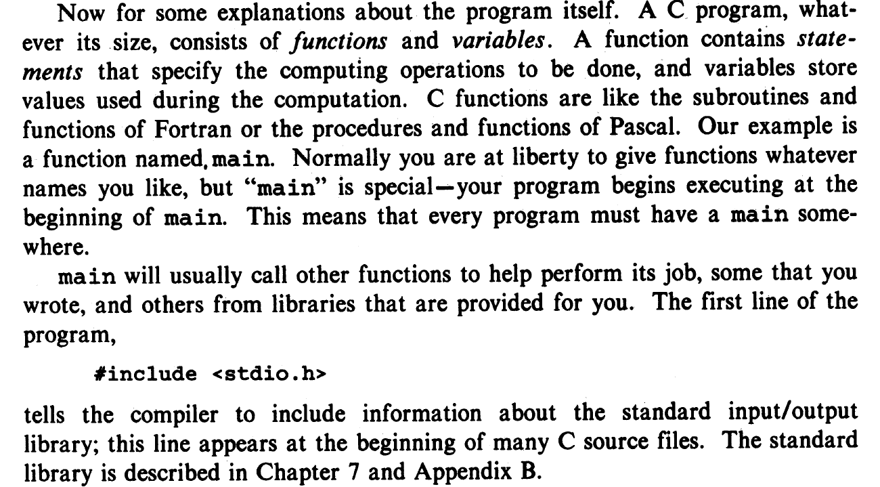

Slide 9
How to Compile
You need to ( you must for this course) install a C compiler on your computer. There are many choices. What I recommend here for those who have a Windows machine is to please download “code blocks” from
http://www.codeblocks.org/downloads
UNLESS YOU ARE VERY SOPHISTICATED, download the binary from the above site.
For quick purposes you can compile and run small programs from the cloud such as https://
www.onlinegdb.com/online_c_compiler
We will show you both.

Slide 10
Homework- 22Sep2021 (you need to do but not submit)
Get a copy of the text book and read just upto and including section 1.1
Download and install codeblocks and run the program discussed in the class.

Slide 11
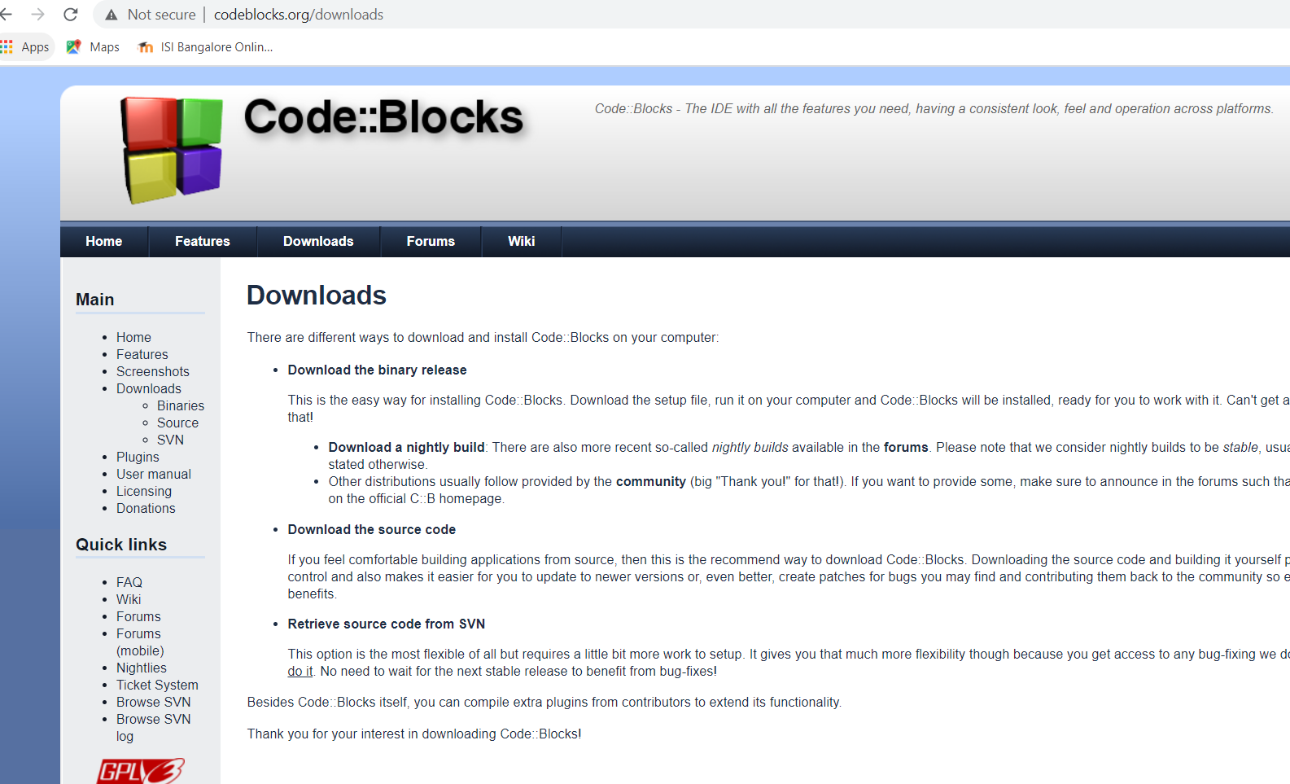

Slide 12
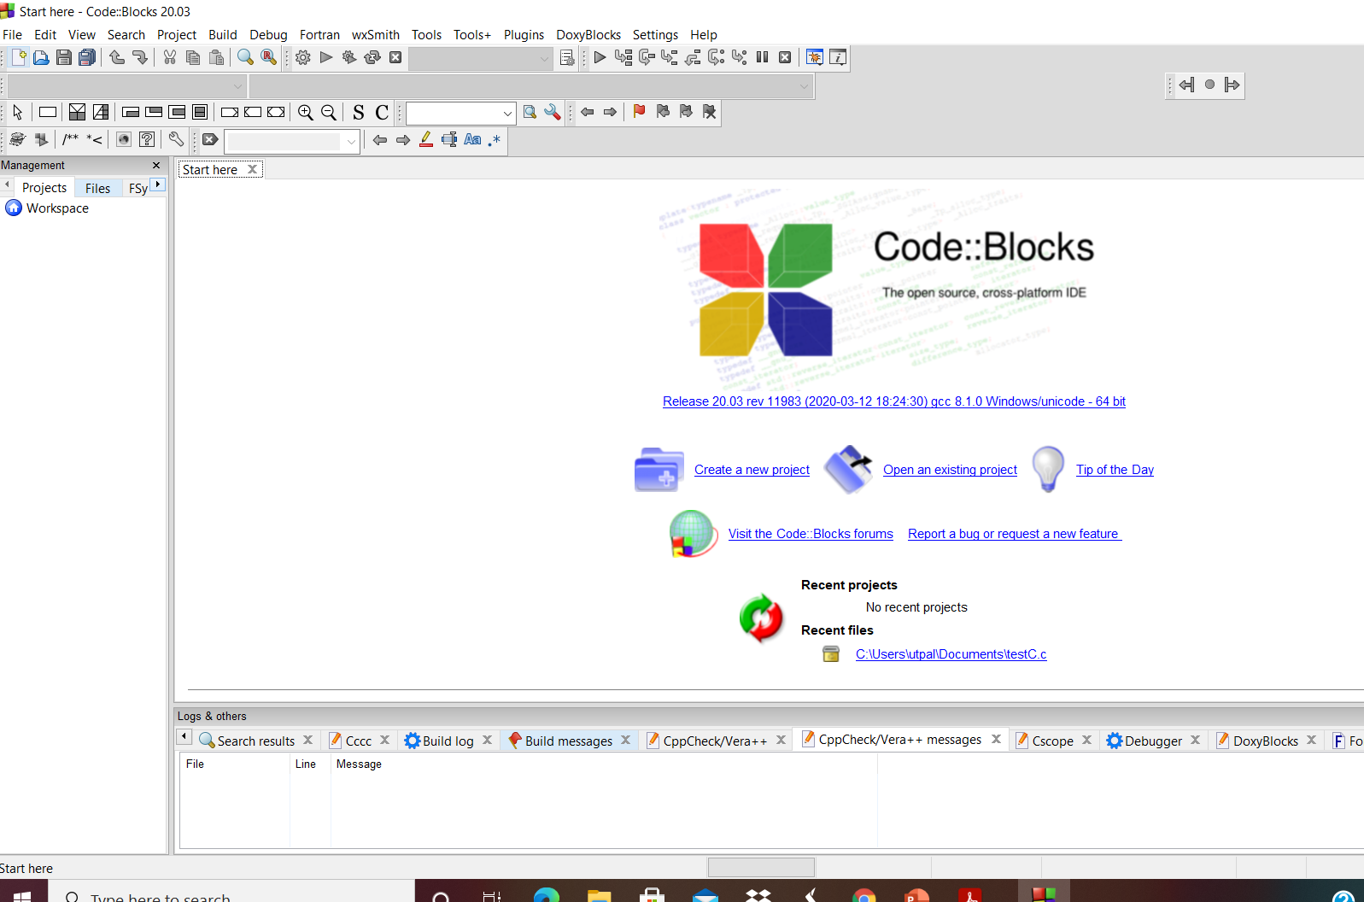
What Codeblocks looks like

Slide 13
Evaluations
In Class Quizzes ( typically once in two /three weeks, the exact date to be communicated in the previous classes. Look for Moodle notifications.
We will do 7 -10 quizzes. We will discard the lowest two marks.
All quizzes will have similar portion but may not have the exact same total marks. We will normalize each quiz to 20 marks when we compare quizzes to decide which to discard.
50% from the Quizzes; Rest 50% in the final exam.
You can contact me in utpal@isibang.ac.in contacting me over moodle is preferred.

Slide 14
Today we will focus on
Functions
Variables
Data Types
Naming variables
Keywords in C

Slide 15
Functions in C
We have already seen two functions
main()
printf(“”)
Generic structure of a function in C
(function return type) name_of_function (argument1, argument2)
{
statement 1;
statement 2;
}

Slide 16
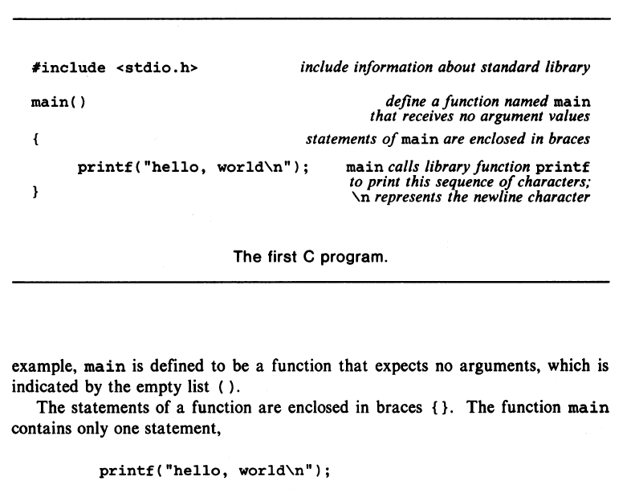

















Slide 17
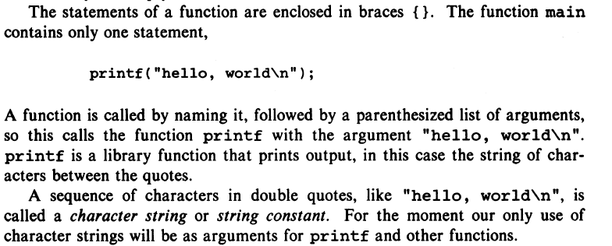

Slide 18
Variables in C
What is a variable?
Suppose you want to compute factorial of a number. Say 100! You must tell the computer that you will provide ( input ) the program with an integer whose value is 100. And then instruct the code what to do with that input. The computer must provide for a space in the memory to keep that integer which it must be able to refer to by a name. This is done by declaring a variable by specifying its type and its name. e.g. in the above example int apx; is a declaration that the variable whose name is apx will be an integer. Its data type is int

Slide 19
Variable
A variable is nothing but a name given to a storage area that our programs can manipulate. Each variable in C has a specific type, which determines the size and layout of the variable's memory; the range of values that can be stored within that memory; and the set of operations that can be applied to the variable.
Variable is the name of memory location. Unlike constant, variables are changeable, we can change value of a variable during execution of a program. A programmer can choose a meaningful variable name. Example : average, height, age, total etc.

Slide 20
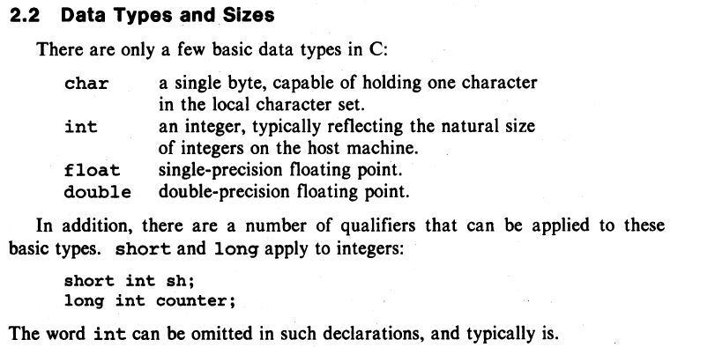
Basic Data types in C
K&R Chapter 2.

Slide 21
Variable Names (From two sources on internet; but check your latest C reference book)
Rules to construct a valid variable name:
1. A variable name may consists of letters, digits and the underscore ( _ ) characters.
2. A variable name must begin with a letter. Some system allows to starts the variable name with an underscore as the first character.
3. ANSI standard recognizes a length of 31 characters for a variable name. However, the length should not be normally more than any combination of eight alphabets, digits, and underscores.
4. Uppercase and lowercase are significant. That is the variable Totamt is not the same as totamt and TOTAMT.
5. The variable name may not be a C reserved word (keyword).
Rules for naming a variable
A variable name can only have letters (both uppercase and lowercase letters), digits and underscore.
The first letter of a variable should be either a letter or an underscore.
There is no rule on how long a variable name (identifier) can be. However, you may run into problems in some compilers if the variable name is longer than 31 characters.

Slide 22
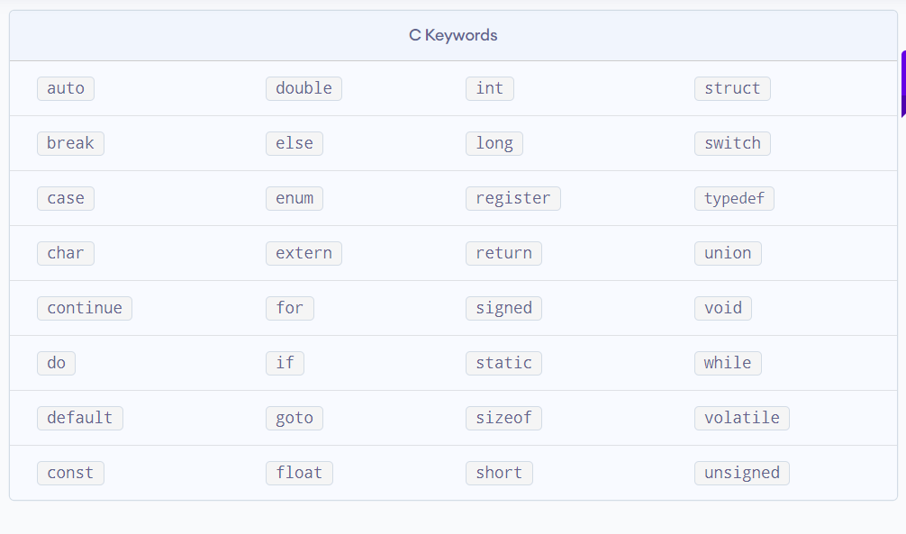
Keywords in C

Slide 23
Write a program to add two numbers
In the following program, three variables of int type declared and assigned values.
The = sign is not the same as in math, it is an assignment operator
Notice printf
#include <stdio.h>
int main()
{
int x, y;
x= 1;
y=2;
int sum;
sum = x + y;
printf("%d", sum);
return 0;
}

Slide 24








Write a program to add two numbers
Same program using a function.
#include <stdio.h>
int add(int i, int j)
{ int sum;
sum= i+j;
return sum;
}
int main()
{
int x, y;
x= 1;
y=2;
int sum;
sum = add(x,y);
printf("%d", sum);
return 0;
}

Slide 25
4 Oct 2020

Slide 26
Quiz on 6 Oct 2021; during class hours.
Look for notification in Moodle

Slide 27
Today we will
Discuss more library functions for standard io
Introduce conditional execution of statements

Slide 28
A property of C functions – worth repeating again and again
A C function returns a value belonging to a datatype.
If it returns an integer, then the datatype of the function will be int
If it does not return a value then its type is void.
The printf function also returns a value as we will see later.
Two more functions we will introduce today getchar and putchar, both are integer type.

Slide 29
How to accept input from the standard input
getchar(), and scanf() functions
The C library function int getchar() gets a character, one character at a time (an unsigned char), from stdin.
The function returns the integer representing the character
int scanf() function is used to read character, string, numeric data from keyboard.
The function returns the number of items of the argument list successfully read. If a reading error happens or the end-of-file is reached while reading, the proper indicator is set (feof or ferror) and, if either happens before any data could be successfully read, EOF is returned.

Slide 30
Simple Examples using getchar, scanf
#include <stdio.h>
int main ()
{
int c;
printf("Enter character: ");
c = getchar();
printf("Integer representing Character entered: %d",c);
return(0);
}

Slide 31
Simple Examples using getchar, scanf
#include <stdio.h>
int main ()
{
int c;
printf("Enter character: ");
c = getchar();
printf("Integer representing Character entered: %d",c);
return(0);
}
The getchar() function obtains a character from stdin. It returns the character that was read in the form of an integer or EOF if an error occurs.

Slide 32
Simple Examples using getchar, scanf
#include <stdio.h>
int main ()
{
char c;
printf("Enter character: ");
c = getchar();
printf("Integer representing Character entered: %d",c);
return(0);
}
This will still work. Why?

Slide 33
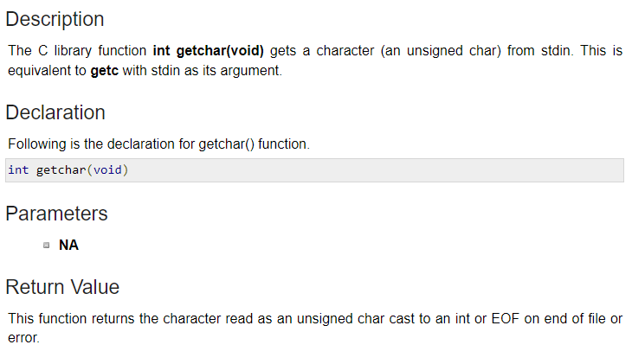
Simple Examples using getchar, scanf
#include <stdio.h>
int main ()
{
char c;
printf("Enter character: ");
c = getchar();
printf("Integer representing Character entered: %d",c);
return(0);
}

Slide 34
Simple Examples using getchar, scanf
#include <stdio.h>
int main ()
{
int c;
printf("Enter character: ");
c = getchar();
printf("Integer representing Character entered: %d",c);
return(0);
}
#include <stdio.h>
int main ()
{
char any;
printf("Enter a character: ");
scanf ("%c" ,&any);
printf("Character entered: %c",any);
return(0);
}

Slide 35
Simple Examples using getchar, scanf
#include <stdio.h>
int main ()
{
int c;
printf("Enter character: ");
c = getchar();
printf("Integer representing Character entered: %d",c);
return(0);
}
#include <stdio.h>
int main ()
{
char any;
printf("Enter a character: ");
scanf ("%c" ,&any);
printf("Character entered: %ch",any);
return(0);
}
What does &any mean in the above program?
The variable name is any. &any represents the memory location of the
variable any ( declared as char) where scanf stores the entered character.

Slide 36
Putchar
Opposite of getchar is putchar.
putchar accepts an integer and returns the character the integer represents.
What will be the output if you enter A ?
Integer representing Character A is 65
A
#include <stdio.h>
int main ()
{
int c;
printf("Enter character: ");
c = getchar();
printf("Integer representing Character entered: %d",c);
putchar(c);
return(0);
}

Slide 37
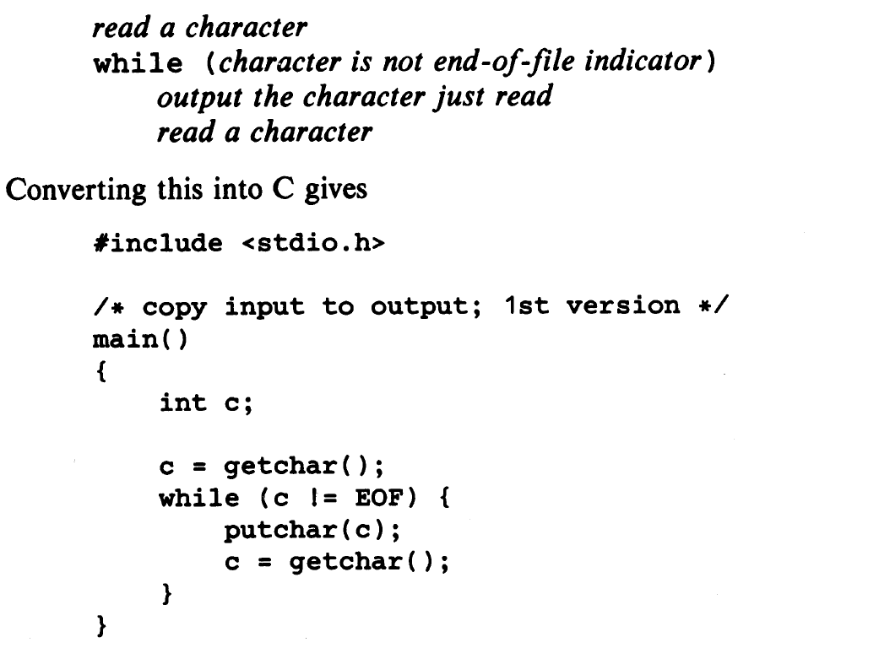
Putting these together: output an input file

Slide 38
More on printf ( formatted output )
Program
#include <stdio.h>
int main()
{
char ch = 'A';
char str[20] = “LearningC";
float pi_upto2digits = 3.14;
int no = 150;
double dbl = 20.123456;
printf("Character is %c \n", ch);
printf("String is %s \n" , str);
printf("Float value is %f \n", flt);
printf("Integer value is %d\n" , no);
printf("Double value is %lf \n", dbl);
printf("Octal value is %o \n", no);
printf("Hexadecimal value is %x \n", no);
return 0;
}

Slide 39
More on printf ( formatted output )
Program
Output
#include <stdio.h>
int main()
{
char ch = 'A';
char str[20] = “LearningC";
float pi_upto2digits = 3.14;
int no = 150;
double dbl = 20.123456;
printf("Character is %c \n", ch);
printf("String is %s \n" , str);
printf("Float value is %f \n", flt);
printf("Integer value is %d\n" , no);
printf("Double value is %lf \n", dbl);
printf("Octal value is %o \n", no);
printf("Hexadecimal value is %x \n", no);
return 0;
}
Character is A String is LearningC Float value is 3.14 Integer value is 150 Double value is 20.123456 Octal value is 226 Hexadecimal value is 9

Slide 40
More on printf ( formatted output )
Program
Output
Note the following:
Need \n so that the outputs are not in different lines.
What will the following statement print?
printf(“Integer value of %5d\n”,no);
3. printf replaces values of the variables in the order they appear. What will the following statement print?
printf(“Integer value of %d and Octal value is %o\n”,no,no);
4. AFIK printf does not support printing binary representation of an integer. Investigate how you can write a function to do that.
#include <stdio.h>
int main()
{
char ch = 'A';
char str[20] = “LearningC";
float pi_upto2digits = 3.14;
int no = 150;
double dbl = 20.123456;
printf("Character is %c \n", ch);
printf("String is %s \n" , str);
printf("Float value is %f \n", flt);
printf("Integer value is %d\n" , no);
printf("Double value is %lf \n", dbl);
printf("Octal value is %o \n", no);
printf("Hexadecimal value is %x \n", no);
return 0;
}
Character is A String is LearningC Float value is 3.14 Integer value is 150 Double value is 20.123456 Octal value is 226 Hexadecimal value is 9

Slide 41
More on printf
The function returns an integer. The return value of printf is the total number of characters it printed.
What will be the output of the following code? Try to answer this without running the code.
#include <stdio.h>
int main(){
char str[] = "I am a student at ISI";
printf(“\nThe value returned by printf() for the above string is : %d", printf("%s", str));
return 0;
}

Slide 42
More on printf
The function returns an integer. The return value of printf is the total number of characters it printed.
What will be the output of the following code? Try to answer this without running the code.
#include <stdio.h>
int main(){
char str[] = "I am a student at ISI";
printf(“\nThe value returned by printf() for the above string is : %d", printf("%s", str));
Return 0;
}
-----------------------------------------------------------------
I am a student at ISI
The value returned by printf() for the above string is : 21
ISI () for th

Slide 43
Conditional execution of statement
While, for, if are used to control execution of statements, either to repeat them until a condition is fulfilled or to execute the statement at all

Slide 44
Loops in C
Conditional execution of statements
Constants in C

Slide 45
while and do while
DO..WHILE –
DO..WHILE loops are useful for things that want to loop at least once. The structure is
do {
} while ( condition );
Notice that the condition is tested at the end of the block instead of the beginning, so the block will be executed at least once.
If the condition is true, we jump back to the beginning of the block and execute it again. A do..while loop is almost the same as a while loop except that the loop body is guaranteed to execute at least once.
A while loop says "Loop while the condition is true, and execute this block of code", a do..while loop says "Execute this block of code, and then continue to loop while the condition is true".
while (condition)
statement;
OR
while (condition)
{
statement 1;
statement2;
}

Slide 46
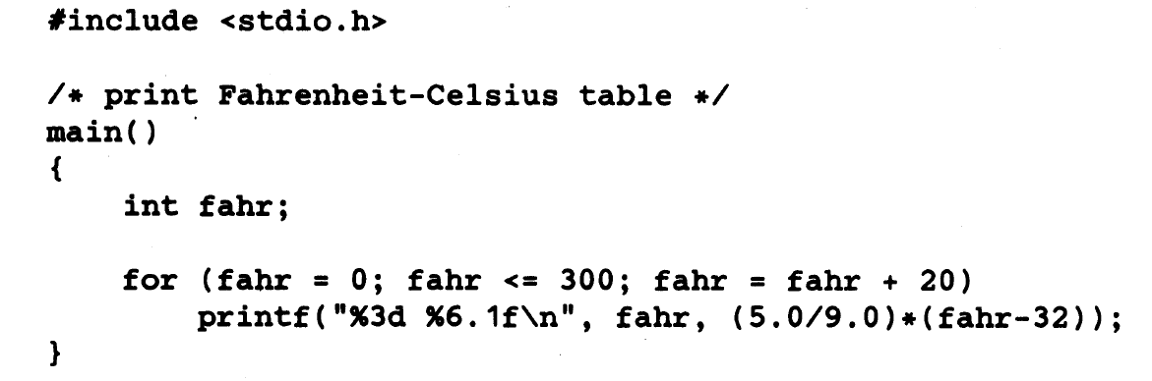
for
for ( variable initialization; condition; variable update ) {
statements to execute while the condition is true
}
// variable updated after each loop BEFORE checking condition
Example:

Slide 47
If else, else if
if (condition)
statement1; //statement1 will be executed only if condition is true
statement 2; ( will be executed whether condition is true or not??)
OR
if(condition)
statement1; //statement1 will be executed only if condition is true
else statement2; //statement2 will be executed only if condition is false
statement3; // will be executed whether condition is true of false

Slide 48
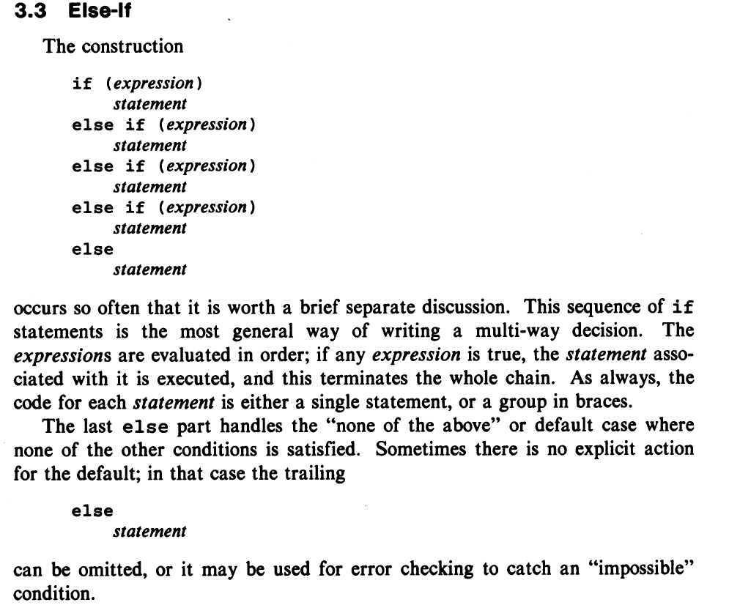
Else-if

Slide 49
A simple example of else if
#include<stdio.h>
int main() {
int marks=83;
if(marks>75)
{ printf("First class"); }
else if(marks>65)
{ printf("Second class"); }
else if(marks>55)
{ printf("Third class"); }
else{ printf("Fourth class"); }
return 0; }

Slide 50
11Oct2021

Slide 51
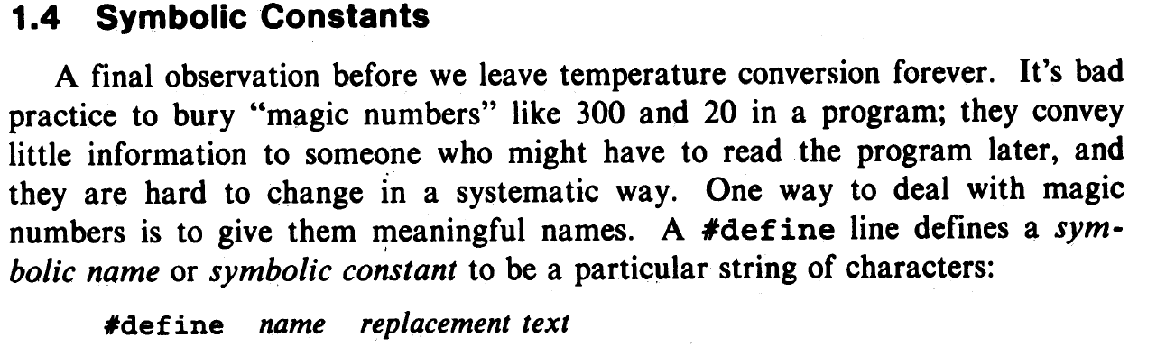
Using CONSTANTS for better coding

Slide 52
Using Symbolic Constants

Slide 53
Character Constants
What is the difference between
putchar(65);
and
putchar(‘A’);

Slide 54
Character Constants
What is the difference between
putchar(65);
and
putchar(‘A’);
BOTH WILL (likely) write A on the standard output.

Slide 55
Character Constants
What is the difference between
putchar(65);
and
putchar(‘A’);
BOTH WILL (likely) write A on the standard output.

Slide 56
In the definition below what is the data type of ‘E ?’
#define E 2.718
Is it float, integer, or will it generate an error?

Slide 57
Write a C Program to change cases of alphabets in input using all that we have discussed.
e.g. the input
I see a RED bull, only ONE (1)
will become
i SEE A red BULL,ONLY one(1)
( Assume that all the upper case ( lower case too) letters are represented by contiguous letters )

Slide 58
Psuedo code ( very important to write something like this before starting to code)
Get a character
While the character is not EOF
If it is a character in the Egnlish Aphabet,
change case
Write to stdio or a file whatever
Else if read next character
Continue with While
End while

Slide 59
Psuedo code ( very important to write something like this before starting to code)
Get a character
While the character is not EOF
If it is a character in the Egnlish Aphabet,
change case
Write to stdio or a file whatever
Else if read next character
Continue with While
End while
HOW To do This?

Slide 60
Psuedo code ( very important to write something like this before starting to code)
Get a character
While the character is not EOF
If it is a character in the Egnlish Aphabet,
change case
Write to stdio or a file whatever
Else if read next character
Continue with While
End while
HOW To do This?
One can add or subtract from a character `A’ – `a’

Slide 61
Write the complete C program now.
Psuedo code ( very important to write something like this before starting to code)
Get a character
While the character is not EOF
If it is a character in the Egnlish Aphabet,
change case
Write to stdio or a file whatever
Read next character
Continue with While
End while
HOW To do This?
One can add or subtract from a character `A’ – `a’

Slide 62
A Program to Change cases of alphabets in input
#include <stdio.h>
int main(){
int nxtlet;
nxtlet = getchar();
while (nxtlet !=EOF)
{
if ((nxtlet>='A') && (nxtlet<='Z'))
putchar(nxtlet +'a'-'A');
else if((nxtlet>='a') && (nxtlet<='z'))
putchar(nxtlet -'a'+'A');
else putchar(nxtlet);
nxtlet= getchar();
}
return 0;
}

Slide 63
Be careful about for syntax

Slide 64
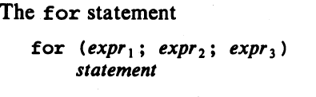
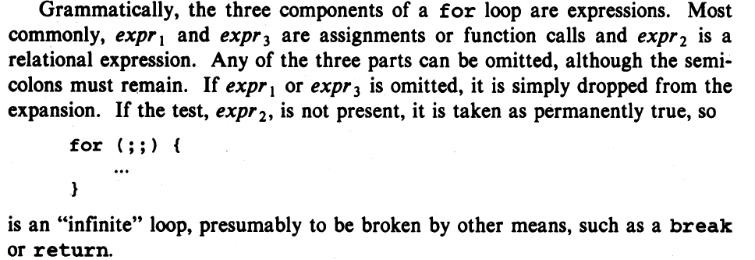
Look at the for statement carefully
What is an expression in C?

Slide 65
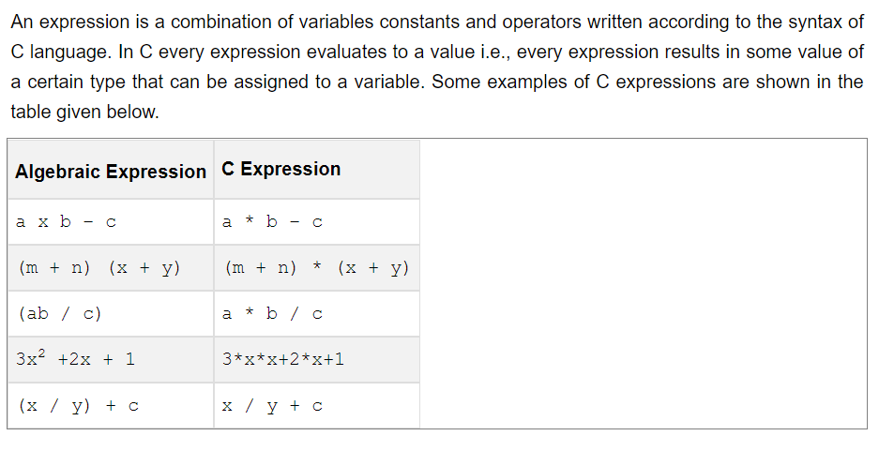
Look at the for statement carefuly
What is an expression in C?

Slide 66
Look at the for statement carefuly
What is an expression in C?

Slide 67
For and While loops are equivalent
The for statement
is equivalent to
……;
while …
….;
….;

Slide 68
For and While loops are equivalent
The for statement
is equivalent to
……;
while …
….;
….;
expr1;
While (expr2)
statement;
expr3;

Slide 69
For and While loops are equivalent
The for statement
is equivalent to
……;
while …
….;
….;
expr1;
While (expr2)
statement;
expr3;

Slide 70
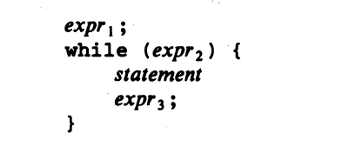
For and While loops are equivalent
The for statement
is equivalent to
……;
while …
….;
….;
expr1;
While (expr2)
statement;
expr3;

Slide 71
Program to count characters in input
Declare and initialize to zero an int variable which will count number of characters
Every time a new character is read, count goes up UNTIL EOF
Print the value of the variable

Slide 72
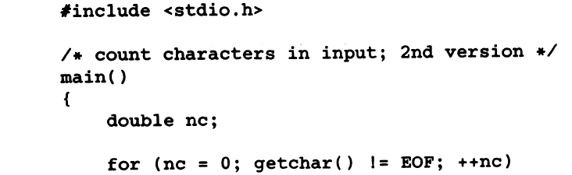

Program to count characters in input
Declare and initialize to zero an int variable which will count number of characters
Every time a new character is read, count goes up UNTIL EOF
Print the value of the variable
What will this print?

Slide 73
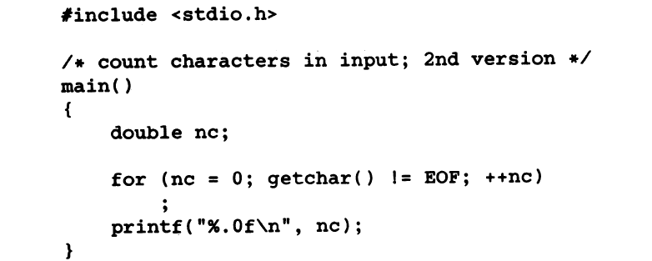
Program to count characters in input
Declare and initialize to zero an int variable which will count number of characters
Every time a new character is read, count goes up UNTIL EOF
Print the value of the variable

Slide 74
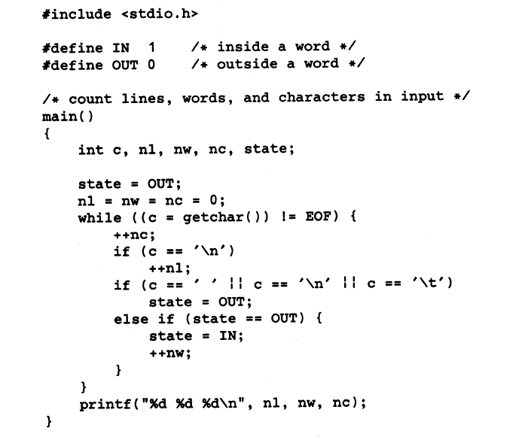
Word count program

Slide 75
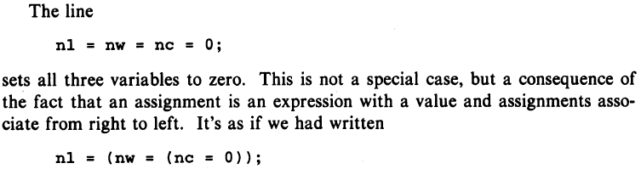
Word count program

Slide 76
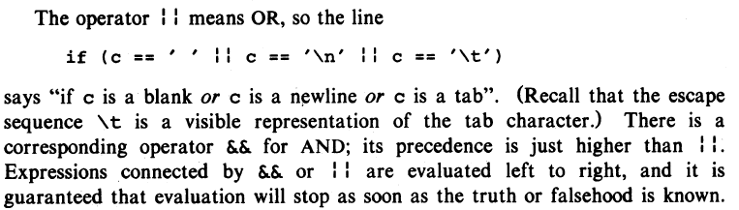
Word count program

Slide 77
Word count program
How will you test the program?

Slide 78
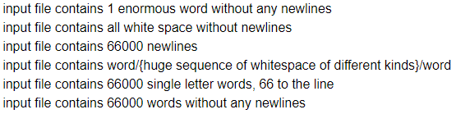
Word count program
What is purpose of testing a code?

Slide 79
Word count program
What is purpose of testing a code?
NEED TO CHECK FOR THESE SITUATIONS + SOME MORE

Slide 80
HW: Modify the Word count program to count number of words of different lengths
Modify the program so you can generate the following report
Word Length Number of Words of that length

Slide 81
Arrays, Functions call, modular programs

Slide 82
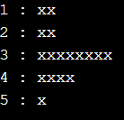
Now we will focus on data structure array and more on writing functions
Count the number of each vowel in the input (stdio)
Draw a histogram showing the frequency of each vowel. E.g.
Here 1,2,3,4,5 stand for a/A,e/E,i/I,o/O,u/U

Slide 83
First Write a program to count the number of each vowel
A,a,E,e,I,i,O,o,U,u
Stat with counting a or A
You have to count both A and a, and give a total count of A and a, etc.

Slide 84
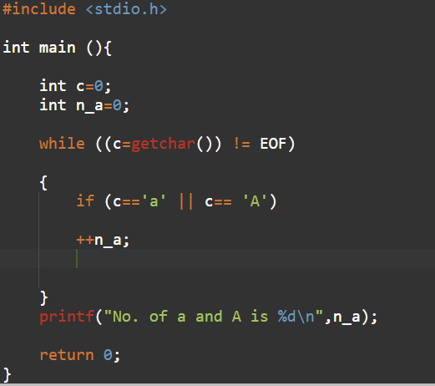
First Write a program to count the number of each vowel
A,a,E,e,I,i,O,o,U,u
Stat with counting a or A
You have to count both A and a,
and give a total count of A and a

Slide 85
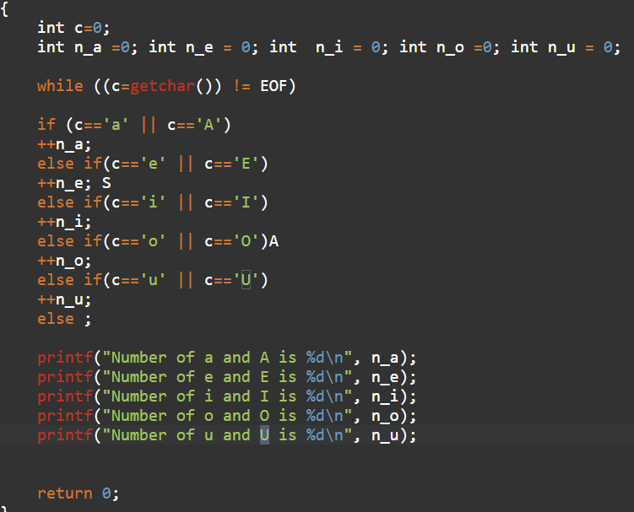
First Write a program to count the number of each vowel

Slide 86
Reviewing a program to count number of vowels

Slide 87
#include <stdio.h>
int main()
{
int c=0;
int n_a , n_e, n_i, n_o,n_u;
n_a= n_e = n_i = n_o= n_u=0;
while ((c=getchar()) != EOF)
{
if(c == 'a' || c=='A')
n_a= n_a+1;
else if (c == 'e' || c=='E')
n_e= n_e+1;
else if (c == 'i' || c=='I')
n_i= n_i+1;
else if (c == 'o' || c=='O')
n_o= n_o+1;
else if (c == 'u' || c=='U')
n_u= n_u+1;
}
printf("The number of a and A is %d \n",n_a);
printf("The number of e and E is %d \n",n_e);
printf("The number of i and I is %d \n",n_i);
printf("The number of o and O is %d \n",n_o);
printf("The number of u and U is %d \n",n_u);
return 0;
}

Slide 88
#include <stdio.h>
int main()
{
int c=0;
int n_a , n_e, n_i, n_o,n_u;
n_a= n_e = n_i = n_o= n_u=0;
while ((c=getchar()) != EOF)
{
if(c == 'a' || c=='A')
n_a= n_a+1;
else if (c == 'e' || c=='E')
n_e= n_e+1;
else if (c == 'i' || c=='I')
n_i= n_i+1;
else if (c == 'o' || c=='O')
n_o= n_o+1;
else if (c == 'u' || c=='U')
n_u= n_u+1;
}
printf("The number of a and A is %d \n",n_a);
printf("The number of e and E is %d \n",n_e);
printf("The number of i and I is %d \n",n_i);
printf("The number of o and O is %d \n",n_o);
printf("The number of u and U is %d \n",n_u);
return 0;
}
int n_v[5]={0,0,0,0,0}; // holds numbers of vowels a/A,e/E,i/I,o/O,u/U
char vowel_lc[ ] = "aeiou";
char vowel_uc[ ] = "AEIOU";
Using an array to store the number of each vowel
for (int i =0; i<5; i=i+1)
printf("The number of %c and %c is %d \n", vowel_lc[i], vowel_uc[i], n_v[i]);

Slide 89
Drawing a horizontal histogram Explain how this program works:
Assume that n_v={4,9,5,3,2}
How many variables would you need to do this?
How many (for ) loops you have to run through?

Slide 90
Drawing a horizontal histogram Explain how this program works:
Assume that n_v={4,9,5,3,2}
What will this print?
// display horizontal histogram
for (int j=0; j<5; j= j+1)
{
for ( int k=n_v[j]; k>0; k=k-1) printf("x");
printf("\n");
}

Slide 91
Drawing a horizontal histogram Write a function that does that.
Assume that n_v={4,9,5,3,2}
// display horizontal histogram
for (int j=0; j<5; j= j+1) // first loop controlling going over each of the FIVE vowels
{
for ( int k=n_v[j]; k>0; k=k-1) printf("x"); //second loop printing as many x as the number of each vowel
printf("\n");
}

Slide 92
Drawing a horizontal histogram Write a function that does that.
Assume that n_v={4,9,5,3,2}
// display horizontal histogram
for (int j=0; j<5; j= j+1)
{
for ( int k=n_v[j]; k>0; k=k-1) printf("x");
printf("\n");
}
Declare the function:
function type
function parameters
Define the function
Calling the function

Slide 93
Drawing a horizontal histogram Write a function that does that.
Assume that n_v={4,9,5,3,2}
// display horizontal histogram
for (int j=0; j<5; j= j+1)
{
for ( int k=n_v[j]; k>0; k=k-1) printf("x");
printf("\n");
}
Declare the function:
function type
function parameters
Define the function
Calling the function

Slide 94
Drawing a horizontal histogram Write a function that does that.
Assume that n_v={4,9,5,3,2}
// display horizontal histogram
for (int j=0; j<5; j= j+1)
{
for ( int k=n_v[j]; k>0; k=k-1) printf("x");
printf("\n");
}
Declare the function:
function type
function parameters
void draw_hist_h(int entry, int data[])

Slide 95
Drawing a horizontal histogram Write a function that does that.
Assume that n_v={4,9,5,3,2}
// display horizontal histogram
for (int j=0; j<5; j= j+1)
{
for ( int k=n_v[j]; k>0; k=k-1) printf("x");
printf("\n");
}
Declare the function:
function type
function parameters
void draw_hist_h(int entries, int entry_values[])
void draw_hist_h(int entries, int entry_values[])
{
for (int j=0; j<entries; j= j+1)
{
for ( int k=entry_values[j]; k>0; k=k-1) printf("x");
printf("\n");
}
}
………..
draw_hist_h(5, n_v);

Slide 96
#include <stdio.h>
void draw_hist_h(int entries, int entry_values[])
{
for (int j=0; j<entries; j= j+1)
{ for ( int k=entry_values[j]; k>0; k=k-1) printf("x");
printf("\n");
}
}
//-----------------------------------------
int main()
{
int c=0;
int n_v[5]={0,0,0,0,0}; // holds numbers of vowels a/A,e/E,i/I,o/O,u/U
char vowel_lc[] = "aeiou";
char vowel_uc[] = "AEIOU";
while ((c=getchar()) != EOF)
{
if(c == 'a' || c=='A')
n_v[0]= n_v[0]+1;
else if (c == 'e' || c=='E')
n_v[1]= n_v[1]+1;
else if (c == 'i' || c=='I')
n_v[2]= n_v[2]+1;
else if (c == 'o' || c=='O')
n_v[3]= n_v[3]+1;
else if (c == 'u' || c=='U')
n_v[4]= n_v[4]+1;
}
for (int i =0; i<5; i=i+1)
printf("The number of %c and %c is %d \n",vowel_lc[i],vowel_uc[i], n_v[i]);
// Draw histogram using the function draw_hist_h, the parameter entries 5 and the entry_value[] is n_v
draw_hist_h(5, n_v);
return 0;}

Slide 97
13Oct2021

Slide 98
Arrays in C
Arrays is a datatype consisting of other (usually but not necessarily more primitive) datatypes.
An array is a collection of similar data items stored at contiguous memory locations
Elements of an array can be accessed randomly using indices of the array – In C, the index begins with 0.
They can be used to store collection of primitive data types such as int, float, double, char, etc of any particular type. To add to it, an array in C can store derived data types such as the structures, pointers etc.

Slide 99
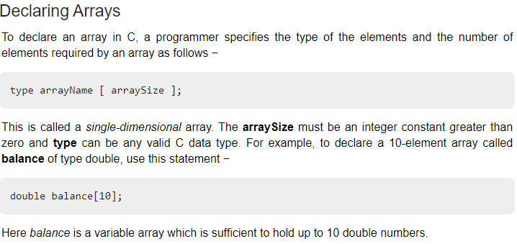
In this example, memory space is created to hold 10 items of double data type. At this stage, they are NOT initialized and the memory locations may have garbage/unusuable data .
Another way to declare and initialize, for example; int marks[]={5,9,3,10,2}. This will create an array of just five elements initialized to these values.

Slide 100
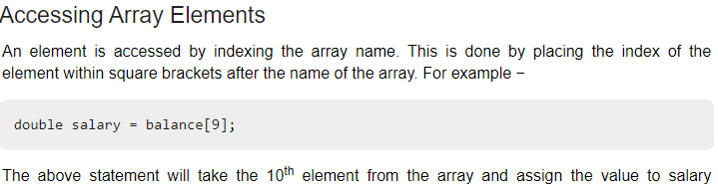
Accessing Array elements
Note that the variable salary is declared and initialized through an assignment.
Also, it is important that balance[9] has already been initialized.
In general, it is important to initialize all the array elements to some default value as soon as possible.

Slide 101
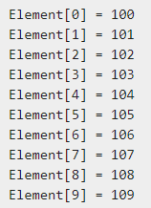
#include <stdio.h>
int main ()
{ int n[ 10 ]; /* n is an array of 10 integers */
int i,j; /* initialize elements of array n to 0 */
for ( i = 0; i < 10; i++ )
{ n[ i ] = i + 100; /* set element at location i to i + 100 */
}
/* output each array element's value */
for (j = 0; j < 10; j++ )
{ printf("Element[%d] = %d\n", j, n[j] ); }
return 0; }
What is the output?

Slide 102
#include <stdio.h>
int main ()
{ int n[ 10 ]; /* n is an array of 10 integers */
int i,j; /* initialize elements of array n to 0 */
for ( i = 0; i < 10; i++ )
{ n[ i ] = i + 100; /* set element at location i to i + 100 */ }
/* output each array element's value */
for (j = 0; j < 10; j++ )
{ printf("Element[%d] = %d\n", j, n[j] ); }
return 0; }
What is the output?

Slide 103
Suppose we wish to store the marks of the students of a class in an integer array so that we can calculate the average, the max etc.
Keep in mind the class size differs from class to class but you can assume a maximum of 100 students.
Assume that for a particular class we have 25 students and their marks are populated in the first 25 elements in the array.
We want to write a generic function find the maximum mark that works for other classes too. What should be the arguments for such a function
int maxMarks(????)
We will continue this discussion in the next class. YOU MAY TRY TO WRITE A COMPLETE PROGRAM WITH SOME DUMMY MARKS, to see if you can write such a function and if it works.
This is a prelude to working with character arrays and strings which we will be discussing in the next few classes.

Slide 104
Quiz on 20Oct2021
Everything from minus infinity to today.

Slide 105
18Oct2021
Passing arguments to a function
Call by Value vs call by reference. Introducing Pointers.
Operator Precedence
Passing an array to a function
Character Arrays; Strings
String Operations

Slide 106
Quiz on 20Oct2021
Everything from minus infinity to last class but today.

Slide 107
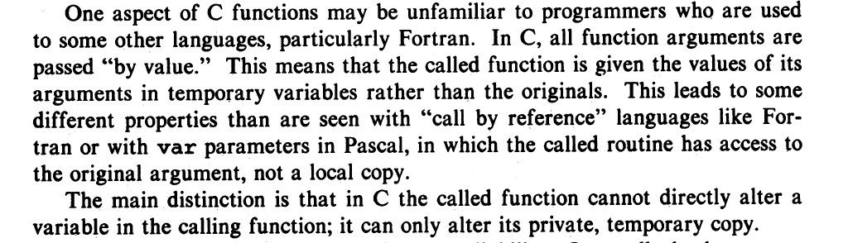
Arguments to functions – from the KR book

Slide 108
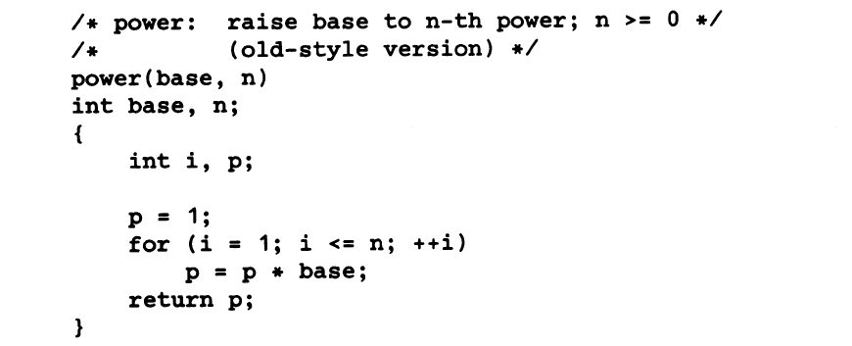
Example: The power function

Slide 109
Example: The power function
In function declaration it is better to have int power( int base, int n)
Here the variable i is redundant.

Slide 110
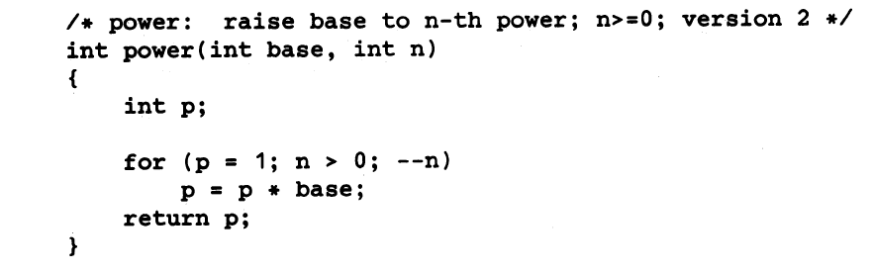
Example: The power function
In function declaration it is better to have int power( int base, int n)
Here the variable i is redundant.

Slide 111
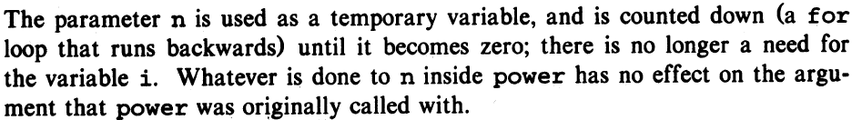
Example: The power function
In function declaration it is better to have int power( int base, int n)
Here the variable i is redundant.

Slide 112
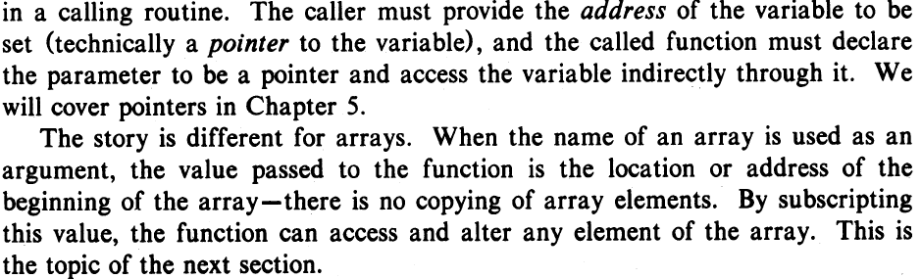

Slide 113
Call by value and Call by reference
Call by value in C
In call by value method, the value of the actual parameters is copied into the formal parameters. In other words, we can say that the value of the variable is used in the function call in the call by value method.
In call by value method, we can not modify the value of the actual parameter by the formal parameter.
In call by value, different memory is allocated for actual and formal parameters since the value of the actual parameter is copied into the formal parameter.
The actual parameter is the argument which is used in the function call whereas formal parameter is the argument which is used in the function definition.

Slide 114
Call by reference in C
In call by reference, the address of the variable is passed into the function call as the actual parameter.
The value of the actual parameters can be modified by changing the formal parameters since the address of the actual parameters is passed.
In call by reference, the memory allocation is similar for both formal parameters and actual parameters. All the operations in the function are performed on the value stored at the address of the actual parameters, and the modified value gets stored at the same address.

Slide 115
Call by value and Call by references
#include<stdio.h>
void change(int num) {
printf("Before adding value inside function num=%d \n",num);
num=num+100;
printf("After adding value inside function num=%d \n", num);
}
int main() {
int x=100;
printf("Before function call x=%d \n", x);
change(x);//passing value in function
printf("After function call x=%d \n", x);
return 0;
}

Slide 116
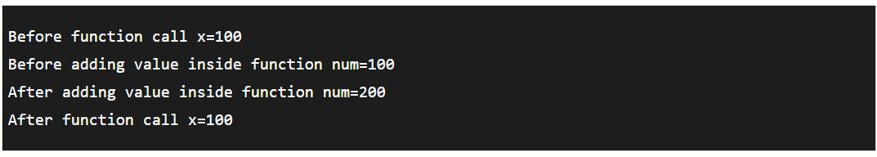
Call by value and Call by references
#include<stdio.h>
void change(int num) {
printf("Before adding value inside function num=%d \n",num);
num=num+100;
printf("After adding value inside function num=%d \n", )um;
}
int main() {
int x=100;
printf("Before function call x=%d \n", x);
change(x);//passing value in function
printf("After function call x=%d \n", x);
return 0;
}

Slide 117
#include <stdio.h>
void swap(int , int); //prototype of the function’
void swap(int a; int b)
{
int temp;
temp = a;
a=b;
b=temp;
printf("After swapping values in function a = %d, b = %d\n",a,b); // Formal parameters, a = 20, b = 10
}
int main()
{
int a = 10;
int b = 20;
printf("Before swapping the values in main a = %d, b = %d\n",a,b); // printing the value of a and b in main
swap(a,b);
printf("After swapping values in main a = %d, b = %d\n",a,b); // The value of actual parameters do not change by changing the formal parameters in call by value, a = 10, b = 20
}

Slide 118
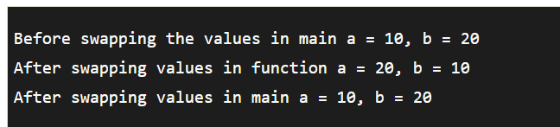
CALL BY REFERENCE does not swap:
#include <stdio.h>
void swap(int , int); //prototype of the function
int main()
{
int a = 10;
int b = 20;
printf("Before swapping the values in main a = %d, b = %d\n",a,b); // printing the value of a and b in main
swap(a,b);
printf("After swapping values in main a = %d, b = %d\n",a,b); // The value of actual parameters do not change by changing the formal parameters in call by value, a = 10, b = 20
}
void swap (int a, int b)
{
int temp;
temp = a;
a=b;
b=temp;
printf("After swapping values in function a = %d, b = %d\n",a,b); // Formal parameters, a = 20, b = 10
}

Slide 119
Call by reference – a example.
#include<stdio.h>
void change(int* num) {
printf("Before adding value inside function num=%d \n",*num);
(*num) += 200;
printf("After adding value inside function num=%d \n", *num);
}
int main() {
int x=100;
printf("Before function call x=%d \n", x);
change(&x);//passing reference in function
printf("After function call x=%d \n", x);
return 0;
}

Slide 120

Call by reference – a example.
#include<stdio.h>
void change(int* num) {
printf("Before adding value inside function num=%d \n",*num);
(*num) += 200;
printf("After adding value inside function num=%d \n", *num);
}
int main() {
int x=100;
printf("Before function call x=%d \n", x);
change(&x);//passing reference in function
printf("After function call x=%d \n", x);
return 0;
}

Slide 121
Call by reference does the swap! INTRODUCING POINTER VARIABLES:
#include <stdio.h>
void swap(int *, int *); //prototype of the function
int main()
{
int a = 10;
int b = 20;
printf("Before swapping the values in main a = %d, b = %d\n",a,b); // printing the value of a and b in main
swap(&a,&b);
printf("After swapping values in main a = %d, b = %d\n",a,b); // The values of actual parameters do change in call by reference, a = 10, b = 20
}
void swap (int *a, int *b)
{
int temp;
temp = *a;
*a=*b;
*b=temp;
printf("After swapping values in function a = %d, b = %d\n",*a,*b); // Formal parameters, a = 20, b = 10
}

Slide 122
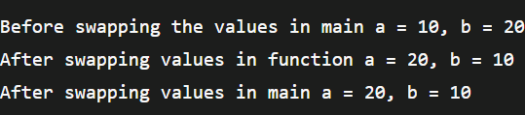
Call by reference does the swap! INTRODUCING POINTER VARIABLES
#include <stdio.h>
void swap(int *, int *); //prototype of the function
int main()
{
int a = 10;
int b = 20;
printf("Before swapping the values in main a = %d, b = %d\n",a,b); // printing the value of a and b in main
swap(&a,&b);
printf("After swapping values in main a = %d, b = %d\n",a,b); // The values of actual parameters do change in call by reference, a = 10, b = 20
}
void swap (int *a, int *b)
{
int temp;
temp = *a;
*a=*b;
*b=temp;
printf("After swapping values in function a = %d, b = %d\n",*a,*b); // Formal parameters, a = 20, b = 10
}

Slide 123
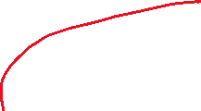

Passing an array to a function in C

Slide 124
HOMEWORK
Please read up on precedence of Operators from the text book on your own. The following slides will serve as a guide

Slide 125
Operators
Arithmetic Operators
Relational and Logical Operators
Increment and Decrement Operators
Bitwise Operators
Assignment Operators and Expressions
Conditional Expressions
Precedence and Order of Evaluaion

Slide 126
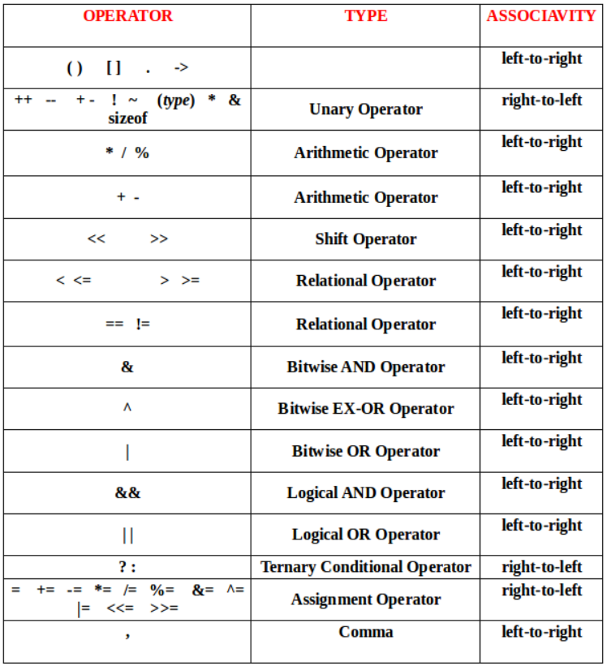

Slide 127
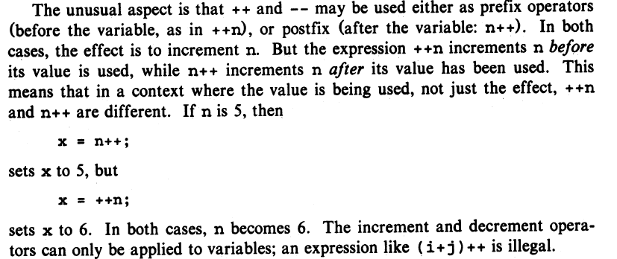

Slide 128


For example,
can be written more compactly as

Slide 129
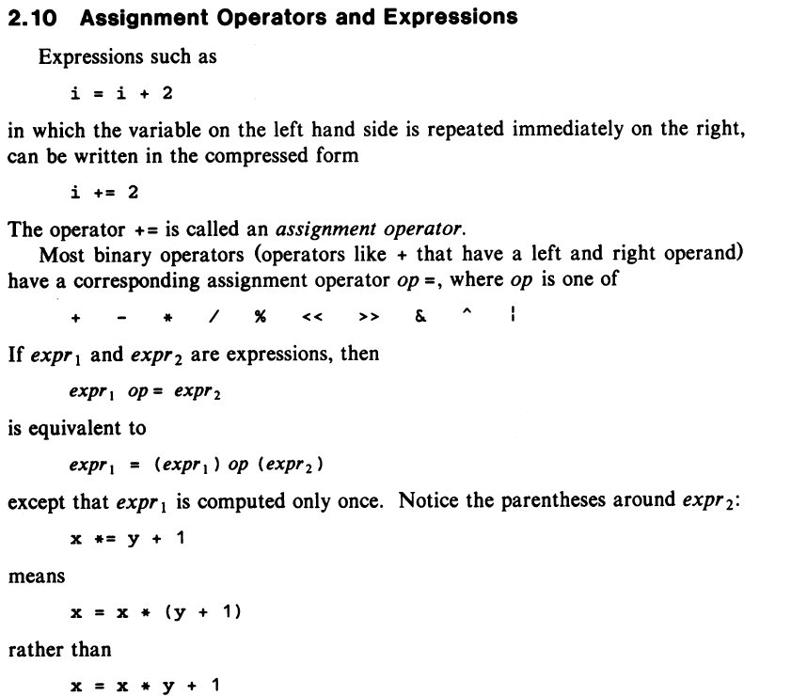

Slide 130
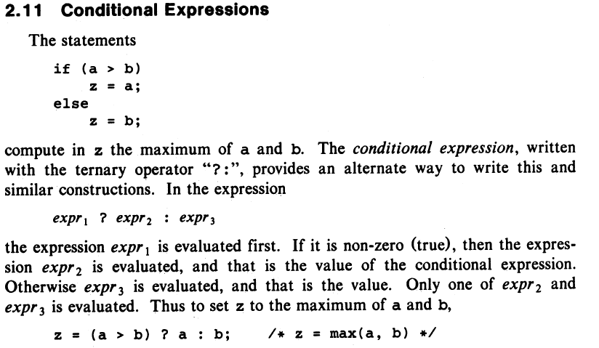

Slide 131
We will discuss the rest of the operands like sizeof, (type) *, & and BIT WISE OPERATORS LATER

Slide 132
27Oct2021
Pointers
Passing an array to a function
Character Arrays; Strings
String Operations

Slide 133
Detailed Discussion on Pointers
Pointer Arithmetic
Array of pointers
Pointer to Pointers
Passing pointers to functions (already doing it)
Return a pointer from functions in C

Slide 134
Pointer Arithmetic
Basic Idea is this: A pointer in c is an address, which is a numeric value. Therefore, One can perform arithmetic operations on a pointer just as one can on a numeric value.
There are four arithmetic operators that can be used on pointers: ++, --, +, and –

Slide 135
Pointer Arithmetic
Basic Idea is this: A pointer in c is an address, which is a numeric value. Therefore, One can perform arithmetic operations on a pointer just as one can on a numeric value.
There are four arithmetic operators that can be used on pointers: ++, --, +, and –
Suppose we have
int *pt1;
pt1 = 1000;
char *pt2; pt2 = 5000;
What will be the values of
pt1=++pt1; pt2= ++pt2

Slide 136
Pointer Arithmetic
Basic Idea is this: A pointer in c is an address, which is a numeric value. Therefore, One can perform arithmetic operations on a pointer just as one can on a numeric value.
There are four arithmetic operators that can be used on pointers: ++, --, +, and –
Suppose we have
int *pt1 = 1000; char *pt2 = 5000
What will be the values of
pt1=++pt1; pt2= ++pt2; [NOT advisable without proper casting or appropriate context – will discuss in a later slide]

Slide 137
Pointer arithmetic: An example
#include <stdio.h>
const int MAX = 3;
int main ()
{ int var[] = {10, 100, 200};
int i, *ptr; /* let us have array address in pointer */
ptr = var;
for ( i = 0; i < MAX; i++)
printf("Address of var[%d] = %x\n", i, ptr ); printf("Value of var[%d] = %d\n", i, *ptr );
/* move to the next location */
ptr++; } return 0; }

Slide 138
Pointer arithmetic: An example
#include <stdio.h>
const int MAX = 3;
int main ()
{ int var[] = {10, 100, 200};
int i, *ptr; /* let us have array address in pointer */
ptr = var;
for ( i = 0; i < MAX; i++)
printf("Address of var[%d] = %x\n", i, ptr ); printf("Value of var[%d] = %d\n", i, *ptr );
/* move to the next location */
ptr++; } return 0; }
What does this var mean in this statement?

Slide 139
Pointer arithmetic: An example
#include <stdio.h>
const int MAX = 3;
int main ()
{ int var[] = {10, 100, 200};
int i, *ptr; /* let us have array address in pointer */
ptr = var;
for ( i = 0; i < MAX; i++)
printf("Address of var[%d] = %x\n", i, ptr ); printf("Value of var[%d] = %d\n", i, *ptr );
/* move to the next location */
ptr++; } return 0; }
In C an array name is the address to the first element of the array; it is a pointer

Slide 140
#include <stdio.h>
const int MAX = 3;
int main ()
{ int var[] = {10, 100, 200};
int i, *ptr; /* let us have array address in pointer */
ptr = var;
for ( i = 0; i < MAX; i++)
printf("Address of var[%d] = %x\n", i, ptr ); printf("Value of var[%d] = %d\n", i, *ptr );
/* move to the next location */
ptr++; } return 0; }
Address of var[0] = bf882b30 Value of var[0] = 100
Address of var[1] = bf882b34 Value of var[1] = 100
Address of var[2] = bf882b38 Value of var[2] = 200

Slide 141
#include <stdio.h>
const int MAX = 3;
int main ()
{ int var[] = {10, 100, 200};
int i, *ptr; /* let us have array address in pointer */
ptr = var;
for ( i = 0; i < MAX; i++) {
printf("Address of var[%d] = %x\n", i, ptr ); printf("Value of var[%d] = %d\n", i, *ptr );
/* move to the next location */
ptr++; } return 0; }
Address of var[0] = bf882b30 Value of var[0] = 100
Address of var[1] = bf882b34 Value of var[1] = 100
Address of var[2] = bf882b38 Value of var[2] = 200
At least two mistakes in this slide

Slide 142
Type Conversion

Slide 143
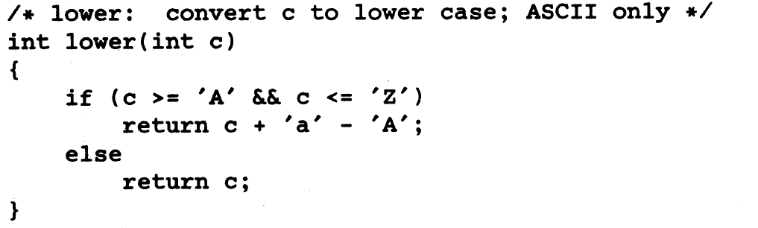
Type Conversion

Slide 144
Type Conversion
Comparing 2 data types in the same expression.
An example of implicit conversion

Slide 145
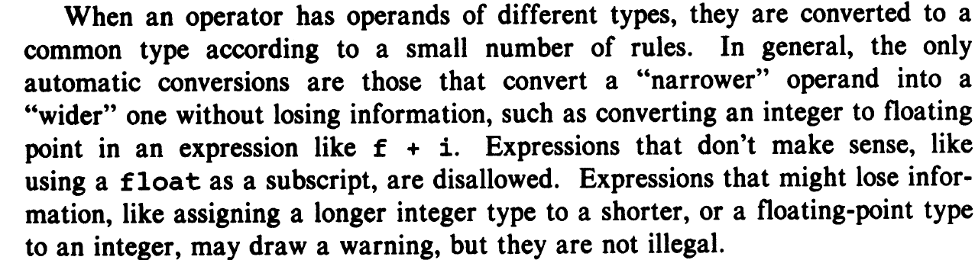
Type Casting
A type cast is basically a conversion from one type to another.
Implicit Type Conversion – done by the compiler on its own
Explicit Type Casting

Slide 146
Type Casting
A type cast is basically a conversion from one type to another.
Implicit Type Conversion – done by the compiler on its own
Explicit Type Casting
// An example of implicit conversion
#include<stdio.h>
int main()
{
int x = 10; // integer x
char y = 'a'; // character c
// y implicitly converted to int. ASCII
// value of 'a' is 97
x = x + y;
// x is implicitly converted to float
float z = x + 1.0;
printf("x = %d, z = %f", x, z);
return 0;
}

Slide 147
Type Casting
A type cast is basically a conversion from one type to another.
Implicit Type Conversion – done by the compiler on its own
Explicit Type Casting
// An example of implicit conversion
#include<stdio.h>
int main()
{
int x = 10; // integer x
char y = 'a'; // character c
// y implicitly converted to int. ASCII
// value of 'a' is 97
x = x + y;
// x is implicitly converted to float
float z ; z= x + 1.0;
printf("x = %d, z = %f", x, z);
return 0;
}

Slide 148
Type Casting
A type cast is basically a conversion from one type to another.
Implicit Type Conversion – done by the compiler on its own
Explicit Type Casting
// An example of implicit conversion
#include<stdio.h>
int main()
{
int x = 10; // integer x
char y = 'a'; // character c
// y implicitly converted to int. ASCII
// value of 'a' is 97
x = x + y;
// x is implicitly converted to float
float z ; z= x + 1.0;
printf("x = %d, z = %f", x, z);
return 0;
}
This is also known as integer promotion

Slide 149
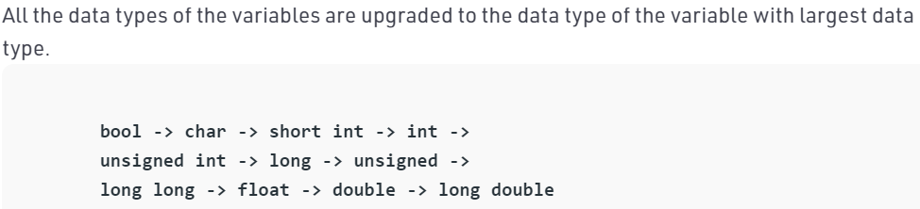
Type Casting
A type cast is basically a conversion from one type to another.
Implicit Type Conversion – done by the compiler on its own
Explicit Type Casting
// An example of implicit conversion
#include<stdio.h>
int main()
{
int x = 10; // integer x
char y = 'a'; // character c
// y implicitly converted to int. ASCII
// value of 'a' is 97
x = x + y;
// x is implicitly converted to float
float z ; z= x + 1.0;
printf("x = %d, z = %f", x, z);
return 0;
}

Slide 150
Explicit type casting
Syntax: (type) expression
// C program to demonstrate explicit type casting
#include<stdio.h>
int main()
{
double x = 1.2;
// Explicit conversion from double to int
int sum = (int)x + 1;
printf("sum = %d", sum);
return 0;
}

Slide 151
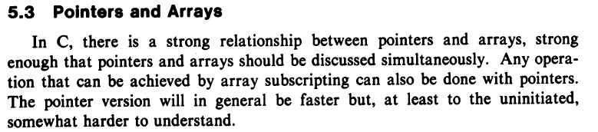

Slide 152
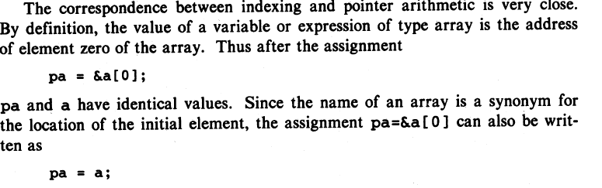

Slide 153
Strings, String functions, Pointers ….
In C programming, a string is a sequence of characters terminated with a null character \0
Example: char c[]=“c string”;
When the compiler encounters a sequence of characters enclosed in the double quotation marks, it appends a null character \0 at the end by default
char c[5]; is a declaration. Then you can feed a string into it subject to the storage you have specified for space for \0

Slide 154
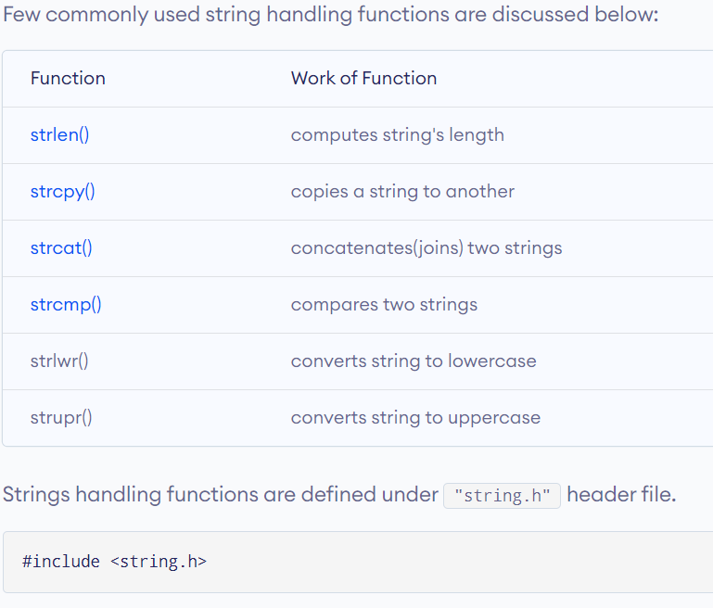
Common string functions

Slide 155
Simple program to find string length
#include <stdio.h>
int main() {
char s[] = “C Programming";
int i;
for (i = 0; s[i] != '\0'; ++i);
printf("Length of the string: %d", i);
return 0; }

Slide 156
Simple program to find string length
Convert this program into a function
What should be the function declaration?
What are the parameters?
What is the function definition?
#include <stdio.h>
int main() {
char s[] = “C Programming";
int i;
for (i = 0; s[i] != '\0'; ++i);
printf("Length of the string: %d", i);
return 0; }

Slide 157
Simple program to find string length
Convert this program into a function
What should be the function declaration?
What are the parameters
What is the function definition
int StringL(char s[])
{
for (int i=0; s[i] != ‘\0’; ++i); return i;
}
#include <stdio.h>
int main() {
char s[] = “C Programming";
int i;
for (i = 0; s[i] != '\0'; ++i);
printf("Length of the string: %d", i); return 0; }

Slide 158
Simple program to find string length
Convert this program into a function
What should be the function declaration?
What are the parameters
What is the function definition
int StringL(char s[])
{
for (int i=0; s[i] != ‘\0’; ++i); return i;
}
#include <stdio.h>
\\ include def of StringL here
int main() {
char s[] = “C Programming";
int i;
for (i = 0; s[i] != '\0'; ++i);
printf("Length of the string: %d", StringL(s));
return 0; }
There is a FATAL Mistake in the definition of the function StringL

Slide 159
Simple program to find string length
Convert this program into a function
What should be the function declaration?
What are the parameters
What is the function definition
int StringL(char s[])
{
for (int i=0; s[i] != ‘\0’; ++i); return i;
}
#include <stdio.h>
int main() {
char s[] = “C Programming";
int i;
for (i = 0; s[i] != '\0'; ++i);
printf("Length of the string: %d", StringL(s));
return 0; }
Rewrite this program using pointers

Slide 160
Simple program to find string length
Convert this program into a function
What should be the function declaration?
What are the parameters
What is the function definition
int StringL(char s[])
{
for (int i=0; s[i] != ‘\0’; ++i); return i;
}
#include <stdio.h>
int main() {
char s[] = “C Programming";
int i;
for (i = 0; s[i] != '\0'; ++i);
printf("Length of the string: %d", i); return 0; }
int String_L(char*s) /* s=&str[0] */
{
int count = 0;
while (*s != '\0') {
count++;
s++;
}
return count;
}

Slide 161
Now we can write a number of sophisticated programs/functions with arrays.
Sort an integer array
Insert into an array
Reverse a string
Copy a string
Sorting an array. Merge sort, Quick sort.

Slide 162
Insert a number in an array of integers
void insert(int a[], int n, int i,) // insert i in the beginning, zeroth place
PLEASE WRITE THE FUNCTION NOW

Slide 163
Insert a number in an array of integers
void insert(int a[], int n, int i,) // insert in in the beginning, zeroth place
1st
7
9
2
8
2nd

Slide 164
Insert a number in an array of integers
void insert(int a[], int n, int i,) // insert in in the beginning, zeroth place
void insert(int a[], int n, int i)
//n is length of array, insert i in the 0th place
{ for (int k=n-1; k >= 0; k--)
{ *(a+k+1)=*(a+k); }
*a=i;
}
1st
7
9
2
8
2nd

Slide 165
Insert a number in an array of integers
REWRITE THE FUNCTION TO insert at the jth place (array[j-1])
void insert(int a[], int n, int i, int j) // insert integer i at the j-th place

Slide 166
Insert a number in an array of integers
REWRITE THE FUNCTION TO insert at the jth place (array[j-1])
void insert(int a[], int n, int i, int j) // insert integer i at the j-th place
VERY SIMPLE MODIFICATION TO
{ for (int k=n-1; k >= 0; k--)
{ *(a+k+1)=*(a+k); }
*a=i;
}

Slide 167
Insert a number in an array of integers
void insert(int a[], int n, int i,) // insert in in the beginning, zeroth place
void insert(int a[], int n, int i)
//n is length of array, insert i in the jth place
{ for (int k=n-1; k >= j; k--)
{ *(a+k+1)=*(a+k); }
*(a+j)=i;
}

Slide 168
Sample Code1
#include <stdio.h>
void insert(int a[], int n, int i) //n is length of array, insert i in the 0th place
{
for (int k=n-1; k >= 0; k--)
{ *(a+k+1)=*(a+k); }
*a=i;}
int main(){
int N[50] = {3,7};
for(int i=0; i<2; i++)
{ printf("%d\n",*(N+i));
}
printf("\nwill insert a number now and then print it out\n");
insert(N,2,5);
for(int i=0; i<3; i++){
printf("%d\n",*(N+i));
}
return 0;
}

Slide 169
Sample Code2
#include <stdio.h>
void insert(int a[], int n, int i, int j) //n is length of array, insert i in the jth place
{
for (int k=n-1; k >= j; k--)
{ *(a+k+1)=*(a+k); }
*(a+j)=i;
}
int main(){
int N[50] = {3,7};
for(int i=0; i<2; i++)
{ printf("%d\n",*(N+i));
}
printf("\nwill insert a number now and then print it out\n");
insert(N,2,5,1);
for(int i=0; i<3; i++){
printf("%d\n",*(N+i));
}
return 0;
}

Slide 170
What is the time complexity of insertion in an array?
On the average how many operations needed to insert at a random array index?

Slide 171
What is the time complexity of insertion in an array?
On the average how many operations needed to insert at a random array index?
O(n), Can be substantial if n is large.
How can we make it O(1), that is independent of the length of the array?
This leads us to a discussion on linked lists, and structures in general which we will discuss later in the course.

Slide 172
Some loose ends to be covered
Scope of Variables
How to read and write into files….
Break, switch…. Etc.

Slide 173
Later to come
Structures
Defining structures
calling structures
memory allocation, deallocation,
Some basic data structures
Some basic algorithm and basic algorithmic complexity considerations.
Some of these will not be covered ibn the K&R book, and supplementary material available on the net will be used for these.

Slide 174
1Nov2021
Scope of Variables

Slide 175
Variable Scope
An object is recognized by its identifier or name. The object may be a variable of basic type or a function, a structure, or a union.
The scope of a variable is the range of program statements that can access that variable.
A variable is visible within its scope and invisible or hidden outside it
We will Look at an example.

Slide 176
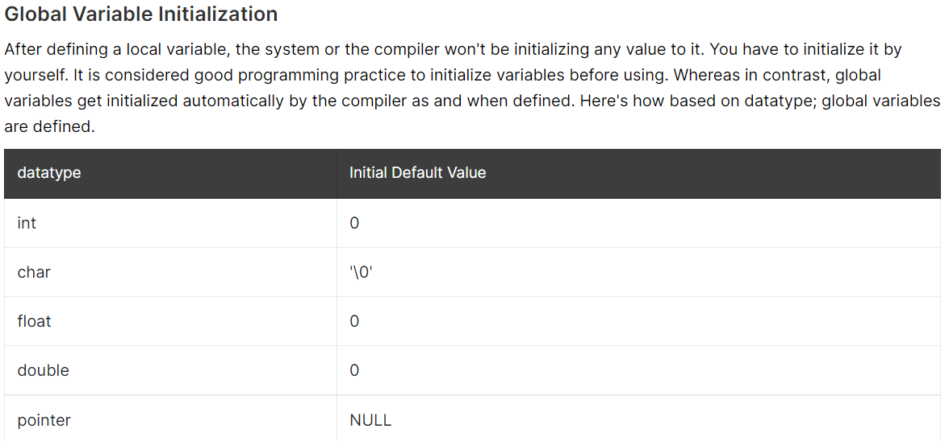

Slide 177
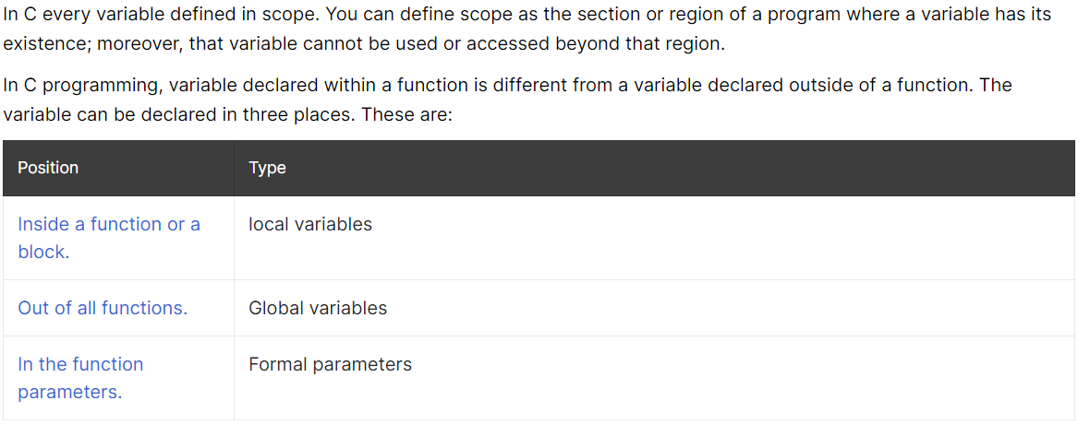
Variable Scope, Global variables

Slide 178



// C program to illustrate the global scope
#include <stdio.h>
// Global variable
int global = 5;
// global variable accessed from
// within a function
void display()
{
printf("%d\n", global);
}
// main function
int main()
{
printf("Before change within main: ");
display();
// changing value of global
// variable from main function
printf("After change within main: ");
global = 10;
display();
}

Slide 179
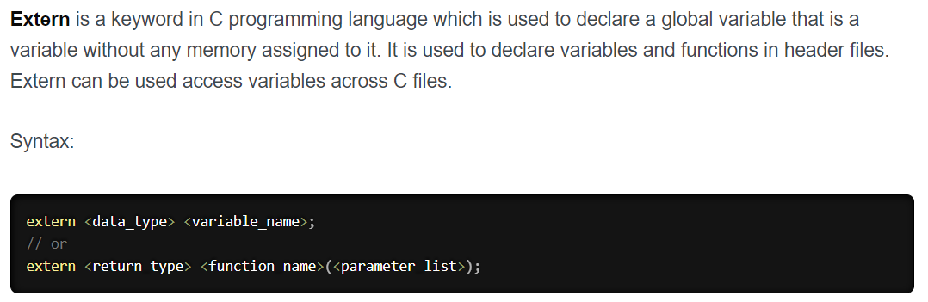


Slide 180


Slide 181


Slide 182
Time Permitting we will discuss storage classes in C later in the course. IN that context we will discuss static and auto variables.

Slide 183
Structure
A structure is a user defined data type. A structure creates a data type that can be used to group items of possibly different types into a single type.
Example:
struct address
{
char street[100];
char city[50];
char state[20];
int pin;
};
struct ind_address
{
char name[50];
struct address name_add;
};

Slide 184
Declaring Structure (Example)
// A variable declaration with structure declaration.
struct Point
{
int x, y;
} p1; // The variable p1 is declared with 'Point'
// A variable declaration like basic data types
struct Point
{
int x, y;
};
int main()
{
struct Point p1; // The variable p1 is declared like a normal variable
}

Slide 185
Initializing Structures
Wrong
struct Point
{
int x = 0; // COMPILER ERROR: cannot initialize members here
int y = 0; // COMPILER ERROR: cannot initialize members here
};
Right
struct Point
{
int x, y;
};
int main()
{
// A valid initialization. member x gets value 0 and y
// gets value 1. The order of declaration is followed.
struct Point p1 = {0, 1};
}

Slide 186
Accessing structure elements
#include<stdio.h>
struct Point
{
int x, y;
};
int main()
{
struct Point p1 = {0, 1};
// Accessing members of point p1
p1.x = 20;
printf ("x = %d, y = %d", p1.x, p1.y);
printf(“Area= %d”, int Area = (p1.x*p1.y)); //WRONG, Area needs to be declared
return 0;
}

Slide 187
Array of Structure
#include<stdio.h>
struct Point
{
int x, y;
};
int main()
{
// Create an array of structures
struct Point arr[10];
// Access array members
arr[0].x = 10;
arr[0].y = 20;
printf("%d %d", arr[0].x, arr[0].y);
return 0;
}

Slide 188
Pointer to a Structure
#include<stdio.h>
struct Point
{
int x, y;
};
int main()
{
struct Point p1 = {1, 2};
// p2 is a pointer to structure p1
struct Point *p2 = &p1;
// Accessing structure members using structure pointer
printf("%d %d", p2->x, p2->y);
return 0;
}

Slide 189
Nested Structure
Nested structure in C is structure within structure. One structure can be declared inside other structure as we declare structure members inside a structure. ( give an example)
The structure variables can be a normal structure variable or a pointer variable to access the data.
More on these later.

Slide 190
struct rect
{
struct Point
{
int x, y;
}
int perimeter;
Int area ;
// you can refer to the structure Point if Point declared outside and global
}

Slide 191
Important Data Structures
Arrays
Linked Lists
Stacks
Queues
Trees
Binary Trees
Heaps
We will cover some of these

Slide 192
8Nov2021

Slide 193
Important Data Structures
Arrays
Linked Lists
Stacks
Queues
Trees
Binary Trees
Heaps
We will cover some of these

Slide 194
Typical Operations involving Data Structures
Arrays, Linked Lists, Stacks, Queues, Trees, Binary Trees, Heaps
All data structures typically have these following functions
Create
Insert
Delete
Read (Retrieve data (information))

Slide 195
Pointers (continued discussion)
There are a few important operations with pointers very frequently.
(a) define a pointer variable,
(b) assign the address of a variable to a pointer and
(c) finally access the value at the address available in the pointer variable. This is done by using unary operator * that returns the value of the variable located at the address specified by its operand.

Slide 196
NULL Pointers
It is a good practice to assign a NULL value to a pointer variable in case an exact address is yet to be assigned. This is done at the time of variable declaration. A pointer that is assigned NULL is called a null pointer.
The NULL pointer is a constant with a value of zero defined in several standard libraries.

Slide 197
In most of the operating systems, programs are not permitted to access memory at address 0 because that memory is reserved by the operating system. However, the memory address 0 has special significance; it signals that the pointer is not intended to point to an accessible memory location. But by convention, if a pointer contains the null (zero) value, it is assumed to point to nothing

Slide 198
To check that the ptr is pointing to something at all, we can and should that the pointer is not NULL
if(ptr) /* succeeds if p is not null */
if(!ptr) /* succeeds if p is null */
OR
if(ptr == NULL) /* succeeds if p is not null */
If(ptr != NULL) /* succeeds if p is null */

Slide 199
Linked List
// A linked list node containing integers
struct Node {
int data1;
struct Node* next;
};

Slide 200

Linked List
// A linked list node containing integers and another structure.
struct Node {
int data1;
struct ind_address data2;
struct Node* next;
};

Slide 201
Like arrays, Linked List is a linear data structure.
Unlike arrays, linked list elements are not stored at a contiguous location
elements are linked using pointers
Clearly you need to identify beginning and end of a linearly linked list!! How?

Slide 202

Like arrays, Linked List is a linear data structure.
Unlike arrays, linked list elements are not stored at a contiguous location
elements are linked using pointers
Clearly you need to identify beginning and end !! How?

Slide 203
Linked List Creation
Define the node type
Define a function that allocates memory for a single node ( consistent with the “sizeof” the node and returns a pointer.

Slide 204
Sizeof is a much used operator in the C. It is a compile time unary operator which can be used to compute the size of its operand. sizeof can be applied to any data-type, including primitive types such as integer and floating-point types, pointer types, or compound datatypes such as Structure, union etc.
#include <stdio.h>
int main()
{
printf("%lu\n", sizeof(char));
printf("%lu\n", sizeof(int));
printf("%lu\n", sizeof(float));
printf("%lu", sizeof(double));
return 0;
}

Slide 205

Sizeof is a much used operator in the C. It is a compile time unary operator which can be used to compute the size of its operand. sizeof can be applied to any data-type, including primitive types such as integer and floating-point types, pointer types, or compound datatypes such as Structure, union etc.
#include <stdio.h>
int main()
{
printf("%lu\n", sizeof(char));
printf("%lu\n", sizeof(int));
printf("%lu\n", sizeof(float));
printf("%lu", sizeof(double));
return 0;
}

Slide 206
// A simple C program to introduce a linked list
#include <stdio.h>
#include <stdlib.h>
struct Node {
int data;
struct Node* next;
};
// Program to create a simple linked list with 3 nodes
int main()
{
struct Node* head = NULL;
struct Node* second = NULL;
struct Node* third = NULL;
// allocate 3 nodes in the heap
head = (struct Node*)malloc(sizeof(struct Node));
second = (struct Node*)malloc(sizeof(struct Node));
third = (struct Node*)malloc(sizeof(struct Node));
/* Three blocks have been allocated dynamically.
We have pointers to these three blocks as head,
second and third
head second third
| | |
| | |
+---+-----+ +----+----+ +----+----+
| # | # | | # | # | | # | # |
+---+-----+ +----+----+ +----+----+
# represents any random value. Data is random because we haven’t assigned anything yet */

Slide 207
// A simple C program to introduce a linked list
#include <stdio.h>
#include <stdlib.h>
struct Node {
int data;
struct Node* next;
};

Slide 208
// A simple C program to introduce a linked list
#include <stdio.h>
#include <stdlib.h>
struct Node {
int data;
struct Node* next;
};
// Program to create a simple linked list with 3 nodes
int main()
{
struct Node* head = NULL;
struct Node* second = NULL;
struct Node* third = NULL;
// allocate 3 nodes in the heap
head = (struct Node*)malloc(sizeof(struct Node));
second = (struct Node*)malloc(sizeof(struct Node));
third = (struct Node*)malloc(sizeof(struct Node));
/* Three blocks have been allocated dynamically.
We have pointers to these three blocks as head,
second and third
head second third
| | |
| | |
+---+-----+ +----+----+ +----+----+
| # | # | | # | # | | # | # |
+---+-----+ +----+----+ +----+----+
# represents any random value. Data is random because we haven’t assigned anything yet */

Slide 209
// A simple C program to introduce a linked list
#include <stdio.h>
#include <stdlib.h>
struct Node {
int data;
struct Node* next;
};
// Program to create a simple linked list with 3 nodes
int main()
{
struct Node* head = NULL;
struct Node* second = NULL;
struct Node* third = NULL;
// allocate 3 nodes in the heap
head = (struct Node*)malloc(sizeof(struct Node));
second = (struct Node*)malloc(sizeof(struct Node));
third = (struct Node*)malloc(sizeof(struct Node));
/* Three blocks have been allocated dynamically.
We have pointers to these three blocks as head,
second and third
head second third
| | |
| | |
+---+-----+ +----+----+ +----+----+
| # | # | | # | # | | # | # |
+---+-----+ +----+----+ +----+----+
# represents any random value. Data is random because we haven’t assigned anything yet */
head->data = 1; // assign data in first node
head->next = second; // Link first node with
// the second node
/* data has been assigned to the data part of the first
block (block pointed by the head). And next
pointer of first block points to second.
So they both are linked.
head second third
| | |
| | |
+---+---+ +----+----+ +-----+----+
| 1 | o----->| # | # | | # | # |
+---+---+ +----+----+ +-----+----+
*/

Slide 210
// assign data to second node
second->data = 2;
// Link second node with the third node
second->next = third;
/* data has been assigned to the data part of the second block (block pointed by second).
And next pointer of the second block points to the third block. So all three blocks are linked.
head second third
| | |
| | |
+---+---+ +---+---+ +----+----+
| 1 | o----->| 2 | o-----> | # | # |
+---+---+ +---+---+ +----+----+ */
third->data = 3; // assign data to third node
third->next = NULL;
/* data has been assigned to data part of third block (block pointed by third). And next pointer of the third block is made NULL to indicate that the linked list is terminated here.
We have the linked list ready.
head
|
|
+---+---+ +---+---+ +----+------+
| 1 | o----->| 2 | o-----> | 3 | NULL |
+---+---+ +---+---+ +----+------+
Note that only head is sufficient to represent the whole list. We can traverse the complete list by following next pointers. */
return 0;
}

Slide 211



Slide 212


Append a node

Slide 213


Inserting a node

Slide 214
Sorting an array of integers
Bubble sort

Slide 215
Sorting an array of integers
Bubble sort
Bubble sort, sometimes referred to as sinking sort, is a simple sorting algorithm that repeatedly steps through the list, compares adjacent elements and swaps them if they are in the wrong order. The pass through the list is repeated until the list is sorted. The algorithm, which is a comparison sort, is named for the way smaller or larger elements "bubble" to the top of the list.

Slide 216
Take an array of numbers " 5 1 4 2 8", and sort the array from lowest number to greatest number using bubble sort. In each step, elements written in bold are being compared. Three passes will be required;
First Pass
( 5 1 4 2 8 ) → ( 1 5 4 2 8 ), Here, algorithm compares the first two elements, and swaps since 5 > 1.
( 1 5 4 2 8 ) → ( 1 4 5 2 8 ), Swap since 5 > 4
( 1 4 5 2 8 ) → ( 1 4 2 5 8 ), Swap since 5 > 2
( 1 4 2 5 8 ) → ( 1 4 2 5 8 ), Now, since these elements are already in order (8 > 5), algorithm does not swap them.
Second Pass
( 1 4 2 5 8 ) → ( 1 4 2 5 8 )
( 1 4 2 5 8 ) → ( 1 2 4 5 8 ), Swap since 4 > 2
( 1 2 4 5 8 ) → ( 1 2 4 5 8 )
( 1 2 4 5 8 ) → ( 1 2 4 5 8 )
Now, the array is already sorted, but the algorithm does not know if it is completed. The algorithm needs one whole pass without any swap to know it is sorted.
Third Pass
( 1 2 4 5 8 ) → ( 1 2 4 5 8 )
( 1 2 4 5 8 ) → ( 1 2 4 5 8 )
( 1 2 4 5 8 ) → ( 1 2 4 5 8 )
( 1 2 4 5 8 ) → ( 1 2 4 5 8 )

Slide 217
Write a C function to do a bubble sort using a C function to swap.
Write a bubble sort function that uses a swap function

Slide 218
//Improved Bubble sort
#include <stdio.h>
void swap(int *xp, int *yp)
{
int temp = *xp;
*xp = *yp;
*yp = temp;
}
// An optimized version of Bubble Sort
void bubbleSort(int arr[], int n)
{
int i, j;
//bool swapped;
for (i = 0; i < n-1; i++)
{
//swapped = false;
for (j = 0; j < n-i-1; j++)
{
if (arr[j] > arr[j+1])
{
swap(&arr[j], &arr[j+1]);
//swapped = true;
}
}
// IF no two elements were swapped by inner loop, then break
//if (swapped == false)
//break;
}
}

Slide 219
Write a C function to do a bubble sort using a C function to swap.
Write the bubblesort function
// Optimized implementation of Bubble sort
#include <stdio.h>
void swap(int *xp, int *yp)
{
int temp = *xp;
*xp = *yp;
*yp = temp;
}
int main() { int arr[] = {64, 34, 25, 12, 22, 11, 90}; int n = sizeof(arr)/sizeof(arr[0]); bubbleSort(arr, n); printf("Sorted array: \n"); printArray(arr, n); return 0; }

Slide 220
Homework
Please understand the C program for bubble sort and optimized bubble sort. Understand how exactly it works.

Slide 221
15Nov2021

Slide 222
A reference to practice C programs ( with strings etc. )
There are many references on the net. You may look up any one of them. In particular take a look at
https://www.w3schools.in/c-program/
Take a look at many of these programs and practice.

Slide 223
Last time we began to discuss two distinct things
- how to define and work with a linear but non-contiguously placed data structure, namely a linearly linked list.
A GOOD REF on LINKED LIST: GO To:
http://cslibrary.stanford.edu/103/
- Search and sorting algorithms.

Slide 224
Today we will continue the discussion on different aspects of search and sort algorithm; how to determine correctness of an algorithm, how to measure complexities of algorithms etc.

Slide 225
Introductory Statements
Typically we need to search for a data item.
We can search for an item by going linearly across the data set. If the size of the data set is n, then it is plausible that we will take time proportional to n.
Why do we need to sort then???
Two reasons:
searching a sorted list is cheaper than searching an unsorted list.
Typically we need to search more than once !!

Slide 226


Slide 227


Slide 228
Sorting Algorithms
Bubble sort
Insertion Sort ( will discuss today)
Selection sort
Merge Sort
Heap sort

Slide 229
Insertion Sort
Idea: like sorting a hand of playing cards
Start with an empty left hand and the cards facing down on the table.
Remove one card at a time from the table, and insert it into the correct position in the left hand
compare it with each of the cards already in the hand, from right to left
The cards held in the left hand are sorted
these cards were originally the top cards of the pile on the table

Slide 230
Insertion Sort
To insert 12, we need to make room for it by moving first 36 and then 24.
6
10
24
36
12

Slide 231
Insertion Sort
6
10
24
36
12

Slide 232
Insertion Sort
6
10
24
36
12

Slide 233
Insertion Sort
input array
5 2 4 6 1 3
at each iteration, the array is divided in two sub-arrays:
left sub-array
right sub-array
sorted
unsorted

Slide 234





Insertion Sort

Slide 235
INSERTION-SORT
Alg.: INSERTION-SORT(A)
for j ← 2 to n
do key ← A[ j ]
Insert A[ j ] into the sorted sequence A[1 . . j -1]
i ← j - 1
while i > 0 and A[i] > key
do A[i + 1] ← A[i]
i ← i – 1
A[i + 1] ← key
Insertion sort – sorts the elements in place
1
2
3
4
5
6
7
8
a₁
a₂
a₃
a₄
a₅
a₆
a₇
a₈
key

Slide 236
How do we know an algorithm works or that it is correct?
The idea is define and track a loop invariant.
A loop invariant is something that remains constant throughout the loop.
It ensures that the algorithm is correct and if it terminates, then it will give a correct result.

Slide 237
Proving Loop Invariants
Proving loop invariants works like induction
Initialization (base case):
It is true prior to the first iteration of the loop
Maintenance (inductive step):
If it is true before an iteration of the loop, it remains true before the next iteration
Termination:
When the loop terminates, the invariant gives us a useful property that helps show that the algorithm is correct
Stop the induction when the loop terminates

Slide 238
Loop Invariant for Insertion Sort
Alg.: INSERTION-SORT(A)
for j ← 2 to n
do key ← A[ j ]
Insert A[ j ] into the sorted sequence A[1 . . j -1]
i ← j - 1
while i > 0 and A[i] > key
do A[i + 1] ← A[i]
i ← i – 1
A[i + 1] ← key
Invariant: at the start of the for loop the elements in A[1 . . j-1] are in sorted order

Slide 239
Loop Invariant for Insertion Sort
Initialization:
Just before the first iteration, j = 2:
the subarray A[1 . . j-1] = A[1], (the element originally in A[1]) – is sorted

Slide 240
Loop Invariant for Insertion Sort
Maintenance:
the while inner loop moves A[j -1], A[j -2], A[j -3], and so on, by one position to the right until the proper position for key (which has the value that started out in A[j]) is found
At that point, the value of key is placed into this position.

Slide 241

Loop Invariant for Insertion Sort
Termination:
The outer for loop ends when j = n + 1 ⇒ j-1 = n
Replace n with j-1 in the loop invariant:
the subarray A[1 . . n] consists of the elements originally in A[1 . . n], but in sorted order
The entire array is sorted!
j - 1
j
Invariant: at the start of the for loop the elements in A[1 . . j-1] are in sorted order

Slide 242
Insertion Sort - Summary
We will discuss these notations
Advantages
Good running time for “almost sorted” arrays ( Θ(n) )
Disadvantages
≈ n²/2 comparisons and exchanges (Θ(n²) running time in worst and average case)

Slide 243

Insertion Sort - Summary

Slide 244
Bubble Sort
Idea:
Repeatedly pass through the array
Swaps adjacent elements that are out of order
Easier to implement, but slower than Insertion sort
i
1
2
3
n
8
4
6
9
2
3
1
j

Slide 245


Slide 246

Selection Sort
Idea:
Find the smallest element in the array
Exchange it with the element in the first position
Find the second smallest element and exchange it with the element in the second position
Continue until the array is sorted
Disadvantage:
Running time depends only slightly on the amount of order in the file

Slide 247
What are the loop invariants in Bubble and Selection sort?

Slide 248
How do we evaluate algorithms?

Slide 249


Slide 250


Slide 251


Slide 252


Slide 253


Slide 254


Slide 255


Slide 256


Slide 257


Slide 258


Slide 259


Slide 260
Bottom line idea on growth of algorithmic time
A+B ln (n) < A+B ln(n) + C n < …. + D(n²) for large enough n ( B, C, D are positive constants, depends on machine etc.

Slide 261
Some References
https://ocw.mit.edu/courses/electrical-engineering-and-computer-science/6-0001-introduction-to-computer-science-and-programming-in-python-fall-2016/lecture-slides-code/MIT6_0001F16_Lec10.pdf
https://www.cse.unr.edu/~bebis/CS477/Lect/InsertionSortBubbleSortSelectionSort.ppt

Slide 262
Detailed Analysis of Insertion Sort
1
2
3
4
5
6
7
8
1
2
3
4
5
6
7
8
a₁
a₂
a₃
a₄
a₅
a₆
a₇
a₈
a₁
a₂
a₃
a₄
a₅
a₆
a₇
a₈
key
key
1
2
3
4
5
6
7
8
a₁
a₂
a₃
a₄
a₅
a₆
a₇
a₈
key

Slide 263
Analysis of Insertion Sort
INSERTION-SORT(A)
for j ← 2 to n
do key ← A[ j ]
Insert A[ j ] into the sorted sequence A[1 . . j -1]
i ← j - 1
while i > 0 and A[i] > key
do A[i + 1] ← A[i]
i ← i – 1
A[i + 1] ← key
cost times
c₁ n
c₂ n-1
0 n-1
c₄ n-1
c₅
c₆
c₇
c₈ n-1
t_{j}: # of times the while statement is executed at iteration j
Notes:
₇

Slide 264
Best Case Analysis
The array is already sorted
A[i] ≤ key upon the first time the while loop test is run (when i = j -1)
t_{j} = 1
T(n) = c₁n + c₂(n -1) + c₄(n -1) + c₅(n -1) + c₈(n-1) = (c₁ + c₂ + c₄ + c₅ + c₈)n + (c₂ + c₄ + c₅ + c₈)
= an + b = Θ(n)
“while i > 0 and A[i] > key”

Slide 265
Worst Case Analysis
The array is in reverse sorted order
Always A[i] > key in while loop test
Have to compare key with all elements to the left of the j-th position ⇒ compare with j-1 elements ⇒ t_{j} = j
a quadratic function of n
T(n) = Θ(n²) order of growth in n²
“while i > 0 and A[i] > key”
using
we have:

Slide 266
Comparisons and Exchanges in Insertion Sort
INSERTION-SORT(A)
for j ← 2 to n
do key ← A[ j ]
Insert A[ j ] into the sorted sequence A[1 . . j -1]
i ← j - 1
while i > 0 and A[i] > key
do A[i + 1] ← A[i]
i ← i – 1
A[i + 1] ← key
cost times
c₁ n
c₂ n-1
0 n-1
c₄ n-1
c₅
c₆
c₇
c₈ n-1
≈ n²/2 comparisons
≈ n²/2 exchanges

Slide 267
Summary
When you add all these terms, the terms proportional to n-square will win !

Slide 269
Growth of Functions. Given functions f and g, we wish to show how to quantify the statement : “g grows as fast as f ”.
The growth of functions is directly related to the complexity of algorithms. We are guided by the following principles.
We only care about the behavior for “large” problems.
We may ignore implementation details such as loop counter incrementation.

Slide 270
Let f and g be functions from the natural numbers to the real numbers. Then g asymptotically dominates f, or
f is big-O of g
if there are positive constants C and k such that
|f (x)| ≤ C|g(x)| for x ≥ k.
Usually we will deal with functions that are manifestly positive at least for “large values of x”.
If f is big-O of g, then we write
f (x) is O(g(x)) or f ∈ O(g).

Slide 271
Example:
Show that x² + 10 is O(x²).
Let C = 3 and k = 3.
Then, if x ≥ 3, 3x² = x² + 2x² ≥ x² + 2 · 3² ≥ x² + 10
Or,
Let C = 2 and k = 4. Then, if x ≥ 4,
2x² = x² + x² ≥ x² + 4² ≥ x² + 10.
So the values of C and k are flexible.
Also note that 3x² = O(x²)
Clearly some general theorems are useful.

Slide 272


THEOREMS: (Without Proof).
x² + 10 ∈ O(x²).

Slide 273
How do you interpret the statement f is not O(g)? That is, how do you negate the definition? The definition says:
f ∈ O(g) if and only if there exist constants C and k such that, for all x, if x ≥ k, then |f (x)| ≤ C|g(x)|.
The negation would then read:
f is not O(g) if and only if for all constants C and k, there exist x such that x ≥ k and |f (x)| > C|g(x)|.
Show that x² is not O(x). ( Prove it)
Show that 2x³ + x² − 3x + 2 is O(x³).

Slide 274

In general,
Then
If k>=d, p(n) is O(x^{k})
A polynomial of degree n is O(x^{n}).

Slide 275

How about log(x) vs x ?
We already know that x is NOT O(log x); easy to show that log x = O(x)
Definition of small o(): If f and g are such that
Theorem: If f is o(g), then f is O(g).

Slide 276
Useful results:
If f₁ is O(g₁) and f₂ is O(g₂), then (f₁+f₂) is O(max{|g₁|, |g₂|}).
If f₁ and f₂ are both O(g), then (f₁ + f₂) is O(g).
If f₁ is O(g₁) and f₂ is O(g₂), then (f₁f₂) is O(g₁g₂).
If f₁ is O(f₂) and f₂ is O(f₃), then f₁ is O(f₃).
If f is O(g), then (af ) is O(g) for any constant a.

Slide 277
22Nov2021

Slide 278
Growth of Functions
Divide and Conquer algorithms
Merge sort
Recurrence relation for Merge sort.
Solving recurrence relations.

Slide 279


Slide 280


Slide 281


Slide 282


Slide 283

MERGE SORT

Slide 284



Suppose you are sorting A = [5, 2, 4, 7, 1, 3, 2, 6].
We divide this into the arrays [5, 2, 4, 7] and [1, 3, 2, 6], and MergeSort each of those arrays.
To sort [5, 2, 4, 7], we divide it into the arrays [5, 2] and [4, 7], and MergeSort each of those arrays.
To sort [5, 2], we divide it into the arrays [5] and [2].
At this point we have reached the base case, so MergeSorting the array [5] just returns the array [5], and MergeSorting the array [2] just returns the array [2].
But now we need to merge together [5] and [2], which gives us [2, 5].
Merging together [2, 5] and [4, 7] gives us [2, 4, 5, 7].
Finally, merging together [2, 4, 5, 7] and [1, 2, 3, 6] gives us [1, 2, 2, 3, 4, 5, 6, 7].

Slide 285


Slide 286











Slide 287
Substitution method of Solving Recurrence Relations:.
Guess the form of the solution.
Use mathematical induction to find the constants and show that the solution works.
Lets try to solve a recurrence relations using this.

Slide 288





Substitution method of Solving Recurrence Relations:.
Guess the form of the solution.
Use mathematical induction to find the constants and show that the solution works.
Lets try to solve a recurrence relations using this.

Slide 289


Slide 290


Slide 292


Slide 293


Slide 294


Slide 295
Ref
https://web.stanford.edu/class/archive/cs/cs161/cs161.1168/lecture1.pdf
https://web.stanford.edu/class/archive/cs/cs161/cs161.1168/lecture2.pdf
https://web.stanford.edu/class/archive/cs/cs161/cs161.1168/lecture3.pdf
https://web.stanford.edu/class/archive/cs/cs161/cs161.1168/lecture2.pdf
https://tildesites.bowdoin.edu/~ltoma/teaching/cs231/fall14/Lectures/02-recurrences/recurrences.pdf

Slide 296
24Nov2021

Slide 297
Last time we discussed the time complexity of merge – sort.
The complexity is O(n log n).
We did this assuming that the time complexity of merging two sorted arrays of length m and n into a sorted array of length m+n is O(m+n)
We will complete this today.

Slide 298
Input: sorted array a of length m, and sorted array b of length n
Create an empty array c of length m+n, set index_a and index_b to 0
While (index_a < length of a) and (index_b < length of b)
Add the smaller of a[index_a] and b[index_b] to the end of c.
Increment the index of c.
Increment the index of the list with the smaller element
If any elements are left over in a or b, add them to the end of c, in order
Return c.

Slide 299






Slide 300











Slide 301














Slide 302














Slide 303
#include <stdio.h>
#include <stdlib.h>
int merge_two_sorted_arrays(int arr1[], int arr2[], int arr3[], int m, int n)
{
int i,j,k;
i = j = k = 0;
for(i=0;i < m && j < n;)
{
if(arr1[i] < arr2[j])
{
arr3[k] = arr1[i];
k++;
i++;
}
else
{
arr3[k] = arr2[j];
k++;
j++;
}
}
while(i < m)
{
arr3[k] = arr1[i];
k++;
i++;
}
while(j < n)
{
arr3[k] = arr2[j];
k++;
j++;
}
}

Slide 304
29NOv2021
Back to Important Structures
Link List
Stack
Binary Trees
Etc.

Slide 305
Adding a node at the header of a link list.
( Ref. http://cslibrary.stanford.edu/103/LinkedListBasics.pdf)

Slide 306

Adding a node at the beginning of the code

Slide 307


Adding a link to the head
Wrong code. Why?

Slide 308

Adding a node to the head of a linked list

Slide 309

Stack as abstract data type

Slide 310

Stack as abstract data type

Slide 311
How to implement a Stack
Can be implemented as array
Needs maximum size of the stack to create an empty stack, then all the functions.
Can be implemented as a linked list
Create a single node.
Push is attaching a node to the top
Pop is reading value at the top and then deleting it from the top ( head)
How will you write Is_full and Is_empty?

Slide 312


Reversing a string using stack and checking if it is a palindrome

Slide 313
Stack implemented as an array
A bounded stack can be implemented as array
We have to know the maximum size
We have to have an indication when the stack is empty ( or full )
We need to store the data in the stack.
So how to we define a stack structure consistent with these?

Slide 314
Stack structure implemented as array
// Data structure for stack
struct stack
{
int maxsize; // define max capacity of stack
int top; //set top to -1 for an empty stack
int *items; // can also write items[]?? items[maxsize]??
};

Slide 315
Functions related to stack implemented as array
// Utility function to initialize stack
struct stack* newStack(int capacity)
{
struct stack *pt = (struct stack*)malloc(sizeof(struct stack));
pt->maxsize = capacity;
pt->top = -1;
pt->items = (int*)malloc(sizeof(int) * capacity);
return pt;
}

Slide 316
Functions related to stack implemented as array
// Utility function to initialize stack
struct stack* newStack(int capacity)
{
struct stack *pt = (struct stack*)malloc(sizeof(struct stack));
pt->maxsize = capacity;
pt->top = -1;
pt->items = (int*)malloc(sizeof(int) * capacity);
return pt;
}
// Utility function to check if the stack is empty or not
int isEmpty(struct stack *pt)
{
return pt->top == -1; // or return size(pt) == 0;
}
// Utility function to check if the stack is full or not
int isFull(struct stack *pt)
{
return pt->top == pt->maxsize - 1;
// or return size(pt) == pt->maxsize;
}

Slide 317
Push and Pop an element
// Utility PUSH function to add an element x in the stack
void push(struct stack *pt, int x)
{
// check if the stack is already full. Then inserting an element would
// lead to stack overflow
if (isFull(pt))
{
printf("OverFlow\nProgram Terminated\n");
exit(EXIT_FAILURE);
}
// add an element and increments the top index
pt->items[++pt->top] = x;
}
Explain how the last line works. How is it adding to the array? Pushed to which location or index to the array?

Slide 318
Push and Pop an element
// Utility PUSH function to add an element x in the stack
void push(struct stack *pt, int x)
{
// check if the stack is already full. Then inserting an element would
// lead to stack overflow
if (isFull(pt))
{
printf("OverFlow\nProgram Terminated\n");
exit(EXIT_FAILURE);
}
// add an element and increments the top index
pt->items[++pt->top] = x;
}
// Utility function to pop top element from the stack
int pop(struct stack *pt)
{
// check for stack underflow
if (isEmpty(pt))
{
printf("UnderFlow\nProgram Terminated\n");
exit(EXIT_FAILURE);
}
// decrement stack size by 1 and (optionally) return the popped element
return pt->items[pt->top--];
}

Slide 319
Peek at the top of the stack
// Utility function to return top element in a stack
int peek(struct stack *pt)
{
// check for empty stack
if (!isEmpty(pt))
return pt->items[pt->top];
else
exit(EXIT_FAILURE);
}

Slide 320
Sample Program illustrating a stack using all these functions
int main() { // create a stack of capacity 5 struct stack *pt = newStack(5); push(pt, 1); push(pt, 2); push(pt, 3); printf("Top element is %d\n", peek(pt)); printf("Stack size is %d\n", size(pt)); pop(pt); pop(pt); pop(pt); if (isEmpty(pt)) printf("Stack is empty"); else printf("Stack is not empty"); return 0; }
Output: Inserting 1 Inserting 2 Inserting 3 Top element is 3 Stack size is 3 Removing 3 Removing 2 Removing 1 Stack is empty

Slide 321

Using Header files to define structure as per you need

Slide 322

Using Header files to define structure as per you need
https://www.cs.uah.edu/~rcoleman/Common/CodeVault/Code/Code120_Stack.html

Slide 323
Application of Stack
Checking parenthesis
Expression handling ( in fix to Pre fix or post fix )
What else?

Slide 324

Check for balanced expressions
Identify what you want to see balanced and what rules apply
e.g. Given an expression string exp, write a program to examine whether the pairs and the orders of “{“, “}”, “(“, “)”, “[“, “]” are correct in exp

Slide 325


Slide 326
#include <stdio.h>
#include <stdlib.h>
#define bool int
// structure of a stack node
struct sNode {
char data;
struct sNode* next;
};
// Function to push an item to stack
void push(struct sNode** top_ref, int new_data);
// Function to pop an item from stack
int pop(struct sNode** top_ref);
// Returns 1 if character1 and character2 are matching left
// and right Brackets
bool isMatchingPair(char character1, char character2)
{
if (character1 == '(' && character2 == ')')
return 1;
else if (character1 == '{' && character2 == '}')
return 1;
else if (character1 == '[' && character2 == ']')
return 1;
else
return 0;
}
// Return 1 if expression has balanced Brackets
bool areBracketsBalanced(char exp[])
{
int i = 0;
// Declare an empty character stack
struct sNode* stack = NULL;
// Traverse the given expression to check matching
// brackets
while (exp[i])
{
// If the exp[i] is a starting bracket then push
// it
if (exp[i] == '{' || exp[i] == '(' || exp[i] == '[')
push(&stack, exp[i]);
// If exp[i] is an ending bracket then pop from
// stack and check if the popped bracket is a
// matching pair*/
if (exp[i] == '}' || exp[i] == ')'
|| exp[i] == ']') {
// If we see an ending bracket without a pair
// then return false
if (stack == NULL)
return 0;
// Pop the top element from stack, if it is not
// a pair bracket of character then there is a
// mismatch.
// his happens for expressions like {(})
else if (!isMatchingPair(pop(&stack), exp[i]))
return 0;
}
i++;
}
// If there is something left in expression then there
// is a starting bracket without a closing
// bracket
if (stack == NULL)
return 1; // balanced
else
return 0; // not balanced
}

Slide 327
01Dec2021

Slide 328
Stack structure implemented as array
// Data structure for stack
struct stack
{
int maxsize; // define max capacity of stack
int top; //set top to -1 for an empty stack
int *items; // can also write items[]?? items[maxsize]??
};
Last time there was a discussion as to whether int *items is correct, how it knows that it is an array ,
and whether int items[], int items[maxsize] would work as well.

Slide 329
A simpler question.
#include <stdio.h>
#include <stdlib.h>
int main()
{
int *elements;
elements = malloc(50*sizeof(int)); // what does this do???
return 0;
}

Slide 330
A simpler question.
#include <stdio.h>
#include <stdlib.h>
int main()
{
int *elements;
elements = malloc(50*sizeof(int)); // what does this do???
elements[19] = 5;
printf(“%d”,elements[19]);
return 0;
}

Slide 331


DECLARATION ONLY; NO ITILIALIZATION
int main()
{
struct mystructure* myStack;
int myStacksize = 100;
myarray = createmyarrayStack(myStacksize);
return 0;
}

Slide 332
int main()
{
struct mystructure* myStack;
int myStacksize = 100;
myarray = createmyarrayStack(myStacksize);
myStack->elements[10]=7;
printf("%d", myStack->elements[10]);
return 0;
}

Slide 333

Compare stack implementations
ARRAY

Slide 334

Compare stack implementations
ARRAY
LINKED LIST

Slide 335
File handling in C
Suppose you have a “text file” in C and you want to append a line at the end.
For example, you have a list of integers and you want to append another integer
Or you want to sort these integers and save the sorted one in another list.
All this calls for reading from a file. Basic Operations are opening a file for a specific purpose ( read, write, append) and closing a file.

Slide 336
When working with files, we need to declare a pointer of type file. This declaration is needed for communication between the file and the program.
In other words, the pointer will store the address required to access the file

Slide 337
When working with files, we need to declare a pointer of type file. This declaration is needed for communication between the file and the program.
In other words, the pointer will store the address required to access the file
Declaration:
FILE *filepointervariablename;

Slide 338
Opening a file
The C function to open a file is fopen

Slide 339

Opening a file
The C function to open a file is fopen

Slide 340


Slide 341
Useful to check if the file could be opened
EXAMPLE:
FILE *fptr;
fptr = fopen("trial1.txt","a");
if(fptr == NULL)
{
printf("Error!");
exit(1);
}

Slide 342
Exercise adding an integer to a file containing integers

Slide 343
HW
Study the following functions
fscanf, fgets, fgetc, fputc ….
fgetc() function is a file handling function in C programming language which is used to read a character from a file. It reads single character at a time and moves the file pointer position to the next address/location to read the next character.

Slide 344
HW:
Sort the numbers in a file containing integers separated by a blank or a newline and save it into a sorted file.

Slide 345
8Dec

Slide 346
HW: Has anyone tried this??
Sort the numbers in a file containing integers separated by a blank or a newline and save it into a sorted file.

Slide 347
HW: Has anyone tried this??
Sort the numbers in a file containing integers separated by a blank or a newline and save it into a sorted file.
Open the File to read:
Store the numbers in an array or a linked list.
Sort the array or the linked list as you find new numbers – What sort program will you use here?
End with End of File.
WRITE THIS PROGRAM – not so easy, neither too difficult

Slide 348
Two Dimensional Arrays.
A way to store a m x n matrix
data_type array_name[x][y];
Example: int x[10][20];
Can store a 10x20 matrix whose elements are integers.

Slide 349
Is there another way to store matrices for practical purposes.
Many applications deal with very very large matrices most of whose elements are zero.

Slide 350
Matrix Operations for Large but Sparse Matrix
Sparse matrix is a matrix ( typically A VERY LARGE matrix) most of whose elements are zero.
The idea is to represent such matrices with a data structure that retains only the non zero elements.
The challenge is to find such a representation and develop time efficient functions such that the “sparse representation” or sparsity is maintained through out.

Slide 351
Unstructured Sparse Matrices
Airline flight matrix.
airports are numbered 1 through n
flight(i,j) = list of nonstop flights from airport i to airport j
n = 1000 (say)
n x n array of list references => 4 million bytes
total number of flights = 20,000 (say)
need at most 20,000 list references => at most 80,000 bytes
Notes:
Assume that flight(i,j) = null if there is no flight from i to j. Of the 1 million entries in the flight matrix at most 20,000 can be nonnull as each nonnull entry represents at least 1 different flight. So we need to store at most 20,000 nonnull entries.

Slide 352
Unstructured Sparse Matrices
Web page matrix.
web pages are numbered 1 through n
web(i,j) = number of links from page i to page j
Web analysis.
authority page … page that has many links to it
hub page … links to many authority pages
Notes:
Web page analyses are done using a matrix such as web(*,*). See IEEE Computer, August 1999, p 60, for a paper that describes Web analysis based on such a matrix. Operations such as matrix transpose and multiply are used.

Slide 353
Web Page Matrix
n = 2 billion (and growing by 1 million a day)
n x n array of ints => 16 * 10¹⁸ bytes (16 * 10⁹ GB)
each page links to 10 (say) other pages on average
on average there are 10 nonzero entries per row
space needed for nonzero elements is approximately 20 billion x 4 bytes = 80 billion bytes (80 GB)
Notes:
On average, 10 entries in each row are nonzero.

Slide 354
Unstructured Sparse Matrices
Notes:
Assume that flight(i,j) = null if there is no flight from i to j. Of the 1 million entries in the flight matrix at most 20,000 can be nonnull as each nonnull entry represents at least 1 different flight. So we need to store at most 20,000 nonnull entries.

Slide 355
A typical representation
Define a structure that has a tuplet array
Each array element is a tuplet[N] ( row, column, value)
We can use the zero element of the array to retain some key information about the original matrix
E.g. tuplet[0] = {no. of rows, no. of columns, no. of nonzero elements Are we saving any space? Only if sparsity <1/3
p = number of non zero elements, p <= (mn)/3 for a m x n matrix

Slide 356
Representation Of Unstructured Sparse Matrices
Single linear list in row-major order.
scan the nonzero elements of the sparse matrix in row-major order
each nonzero element is represented by a triple
(row, column, value)
the list of triples may be an array list or a linked list (chain)

Slide 357



Slide 358


Slide 359
Retrieving a row information vs Retrieving a column
How many non zero element are in a row or a column?
To do that for a row is simple. Complexity?
To do that that a column is not so simple
Complexity?

Slide 360
Retrieving a row vs Retrieving a column
How many non zero elements are there in a specific row or a specific column?
To do that for a row is simple. ‘=
Complexity O(p) = O(mn)
To do that that a column is not so simple
Complexity O(p*n) = O(mn²), But we can devise an algorithm to convert it to O(mn) { we will not prove it here}

Slide 361
Any important problem in dealing with sparse matrix is how to transpose a sparse matrix by keeping its properties intact. We will not discuss this here except to note that there are algorithms to do this efficiently.

Slide 362
Multiplying Polynomials.
How do we represent polynomials?
How do we add? What is the time complexity?
How do we multiply polynomials?

Slide 363
The Polynomial Multiplication Algorithm

Slide 364

The Polynomial Multiplication Algorithm

Slide 365
The Polynomial Multiplication Algorithm
Implement each polynomial as an array of the coefficients

Slide 366
What is the complexity in terms of the degree of the polynomial ?

Slide 367

What is the complexity in terms of the degree of the polynomial ?

Slide 368

What is the complexity in terms of the degree of the polynomial ?

Slide 369

Divide and Conquer – First Try

Slide 370

Divide and Conquer – First Try

Slide 371


Divide and Conquer – First Try

Slide 372


Slide 373


Slide 374


Slide 375


Slide 376






Slide 377
Lesson
Divide and Conquer may not be the silver bullet
You have to think deeper.

Slide 378
What can we do? How can we reduce steps?
Note that these middle two terms can be combined because they have the same coefficients!!!
So we need to only compute

Slide 379




What can we do? How can we reduce steps?
Note that these middle two terms can be combined because they have the same coefficients!!!
So we need to only compute
+

Slide 380


Slide 381



Slide 382


Slide 383


Slide 384
13 Dec. 2021
Quick Sort.

Slide 385
Quicksort is a sorting algorithm based on the divide and conquer approach where
An array is divided into subarrays by selecting a pivot element (element selected from the array).
While dividing the array, the pivot element should be positioned in such a way that elements less than pivot are kept on the left side and elements greater than pivot are on the right side of the pivot.
The left and right subarrays are also divided using the same approach. This process continues until each subarray contains a single element.
At this point, elements are already sorted. Finally, elements are combined to form a sorted array.

Slide 386


Slide 387


Slide 388


Slide 389
There are many different versions of quickSort that pick pivot in different ways.
Always pick first element as pivot.
Always pick last element as pivot
Pick a random element as pivot.
Pick median as pivot.

Slide 390


Slide 391


Slide 392


Slide 393


Slide 394


Slide 395

Quick sort

Slide 396


Slide 397


Slide 398


Slide 399
20Dec2021

Slide 400
Miscellaneous and Closing

Slide 401
int main()
/* Explain the code – what is it doing?*/
{
FILE *fp;
int no_lines = 0;
char filename[40]; //what is this line doing?
char sample_chr;
printf("Enter file name: ");
scanf("%s", filename);
fp = fopen(filename, "r"); //what is this line doing?
sample_chr = getc(fp);

Slide 402
int main()
/* Explain the code – what is it doing?*/
{
FILE *fp;
int no = 0;
char filename[40], //what is this line doing?
char sample_chr;
printf("Enter file name: ");
scanf("%s", filename);
fp = fopen(filename, "r"); //what is this line doing?
sample_chr = getc(fp);//what dies this line do?
while (sample_chr != EOF) {
if (sample_chr == ‘/n')
{
//increment variable 'no' by 1
no=no+1;
}
//take next character from file.
sample_chr = getc(fp);
}
// WHAT IS THE WHILE LOOP DOING?
fclose(fp); //close file.
printf(" %d %s ", no, filename);
return 0;
}

Slide 403
Tower of Hanoi
Tower of Hanoi is a mathematical puzzle where we have three rods and n disks. The objective of the puzzle is to move the entire stack to another rod, obeying the following simple rules:
Only one disk can be moved at a time.
Each move consists of taking the upper disk from one of the stacks and placing it on top of another stack i.e. a disk can only be moved if it is the uppermost disk on a stack.
No disk may be placed on top of a smaller disk.

Slide 404


Slide 405
#include <stdio.h>
void TOH(int n,char x,char y,char z)
{ if(n>0)
{ TOH(n-1,x,z,y);
//printf("\n%c to %c",x,y);
TOH(1,x,y,z);
TOH(n-1,z,y,x);
}
}
int main()
{
int n=5;
TOH(n,'A','B','C');
return 0;}

Slide 406
#include <stdio.h>
void TOH(int n,char x,char y,char z)
{ if(n>0)
{ TOH(n-1,x,z,y);
//printf("\n%c to %c",x,y);
TOH(n-1,z,y,x);
}
}
int main()
{
int n=5;
TOH(n,'A','B','C');
return 0;}
How many time printf executed?
How will you modify the program to count it?

Slide 407
T(n) = T(n-1) + c + T(n-1)
T(n) - 2 T(n-1) + c
#include <stdio.h>
void TOH(int n,char x,char y,char z)
{ if(n>0)
{ TOH(n-1,x,z,y);
printf("\n%c to %c",x,y);
TOH(n-1,z,y,x);
}
}
int main()
{
int n=5;
TOH(n,'A','B','C');
return 0;}
What the time complexity of this algorithm?

Slide 408
The End

